Slide 1
Unifying HPC and Cloud Systems
A Containerized Approach for the Integrated Forecast System
Cathal O'Brien, Armagan Karatosun, Adrian Hill, Paul Cresswell, Michael Sleigh, Ioan Hadade
cathal.obrien@ecmwf.int armagan.karatosun@ecmwf.int
https://doi.org/10.5194/egusphere-egu24-9795

Slide 2
Who are we?
Team Work
Cathal O'Brien --> on HPC-optimized Containers
Paul Cresswell --> Technical point of contact for IFS cycles
Adrian Hill --> OpenIFS implementation
Armagan Karatosun
Cloud Computing Engineer
ECMWF
and others...

Slide 3
Introduction
The IFS [1] (Integrated Forecast System) is a global numerical weather prediction system maintained by the European Centre for Medium-Range Weather Forecasts (ECMWF).
It includes a sophisticated data assimilation system and global numerical model of the Earth system, as well as supporting infrastructure to make forecast products available to our Member and Co-operating States and other users.
Undergoes regular updates - "Cycles"
OpenIFS [2]
An easy-to-use version of the ECMWF IFS (Integrated Forecasting System). Provides the forecast capability of IFS (no data assimilation), supporting software, and documentation.
AIFS [3] (machine learning model)
[1] https://www.ecmwf.int/en/forecasts/documentation-and-support/changes-ecmwf-model [2] https://www.ecmwf.int/en/research/projects/openifs
[3] https://www.ecmwf.int/en/about/media-centre/aifs-blog/2023/ECMWF-unveils-alpha-version-of-new-ML-model

Slide 4
Motivation to run IFS in a Container
Traditionally, ECMWF’s high-performance computing facility (HPCF) is responsible for operationally supporting the IFS cycles. However;
With the emergence of new cloud technologies,
initiatives such as Destination Earth (DestinE)
AI/ML or GPU-optimized workloads
Possibility to run IFS on external HPC systems (e.g., EuroHPC)
Growth of OpenIFS users within Europe and around the globe
the need to run IFS outside of ECMWF's computing facilities became more evident.​

Slide 5
From humble beginnings
IFS has a testing suite called "ifstest" which can build the full IFS and its dependencies (e.g. ecCodes) and run a set of tests.
These are self-contained meaning, there is no need for some internal dependencies (e.g, MARS or ecFlow)
Allows individual developers to run tests on their local environments to get quick feedback as they work on a branch.
Problem Solved? Not really...
Although "this is great™", it still involves a lot of "brew install" stuff that developers should not worry about in the first place. ​
In addition, the developer is bound with the SW available on HPC/their local machine.
Still, this showed that it can work outside of HPC.

Slide 6
To an idea
An idea might be to provide "disposable" environments for the developers;
They can trigger the tests with the desired compiler versions
With different compilers (GNU vs Intel).
Optimized and centralized builds
On different platforms ( generic x86-64 or HPC)

Slide 7
How?
We have identified several ways to achieve this.
TLDR; It all boils down on "Portability vs Performance" dilemma
Using Compiler Images (Portable)
Both GNU and Intel have compiler images.
The GNU one is perfect, it has multiple versions available and the base operating system is pretty slim. It is very portable.
The idea here is to have a different image for each compiler set, instead of having one big image with all the compiler versions or other dependencies are installed.
docker pull ifs-test:gnu-12.2.0_mpi-4.1.5-v1.0
docker pull ifs-test:gnu-9.5.0_mpi-3.1.2-v1.0

Slide 8
Focusing on portability
The (potential) advantages of this approach are:
The use of stackable images (i.e. composing images from other images) allows flexibility to swap components of the build (e.g. different compilers)
Caching (Image layers) to avoid unnecessary recompilation when an unrelated change requires rebuilding.
The flexibility to choose where the libraries come from. For instance, we may choose to compile some of the required libraries ourselves. (currently, CMAKE and OpenMPI)
Provides a significant level of portability
The (potential) disadvantages of this approach are:
Build time might be too long, if we end up compiling many things from source. Currently the image build takes (with ifs-bundle) in ˜25 minutes.
GCC-12 image base image, building OpenMPI and CMAKE from source.
Proprietary libraries may be a problem
The libraries will be compiled with generic set of flags, without any (possible) performance optimizations.

Slide 9
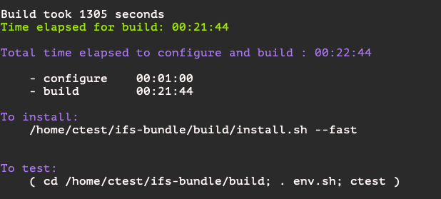
Results are in!
Combining GNU compiler images with custom OpenMPI builds
The build takes (with ifs-bundle)
Minimum ˜22 minutes. (if you don’t make any changes on the image)
˜35 minutes for full build
Currently based on gcc:12.2.0-bullseye image
Compiles OpenMPI-4.1.4 and CMAKE-3.26.1 from source
IFS cycle CY49R1 and OpenIFS 48r1
Layered nature of container images helped reduce building time by skipping unchanged layers

Slide 10
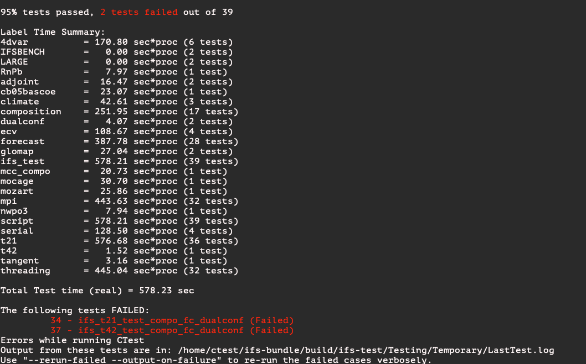
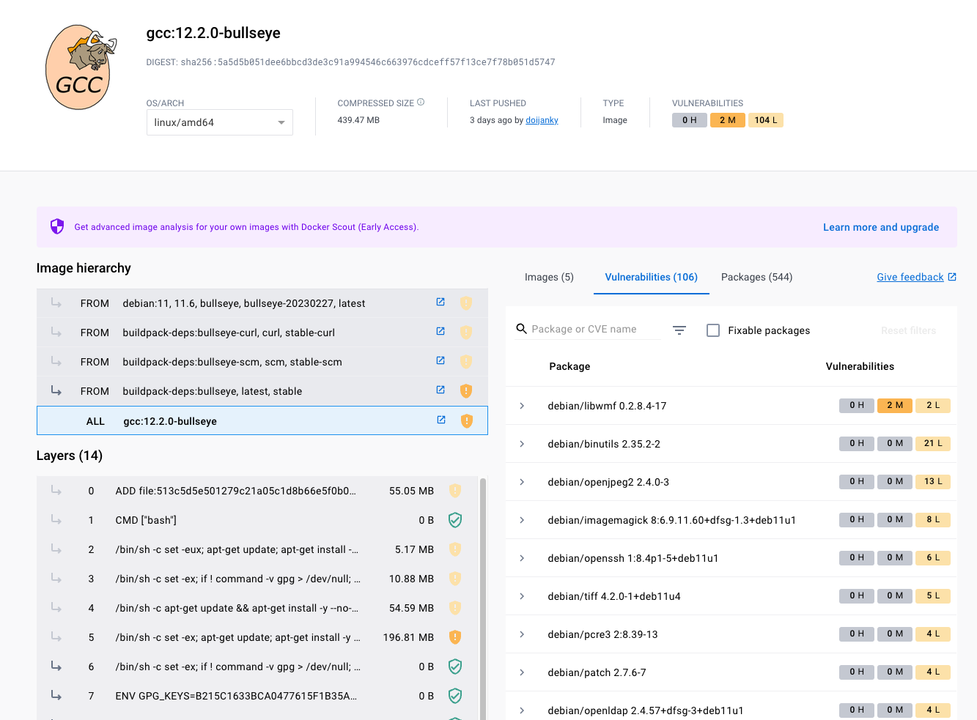
Results are in!
Running the tests are simple,
docker run -it ifs-test:ubuntu-22.04-gcc12.2-cmake-3.26.1-v1.5

Slide 11
Results are in!
Proves IFS can work in a container.
OpenIFS 48r1 (released in Jan 2024) includes a Dockerfile, that permits users to set-up a linux container with all the appropriate packages and environment variables set-up.
The user only needs to run "docker build" and "docker run" to run OpenIFS-test (a scaled down version of ifs-test).
The Dockerfile works with GNU 11.2 and GNU 12 and there is a plan to maintain the container capability for future OpenIFS releases.
Dockerfile has been tested on Mac (M1) and Ubuntu 22.04.
Dockerfile also acts as a recipe for a clean install

Slide 12
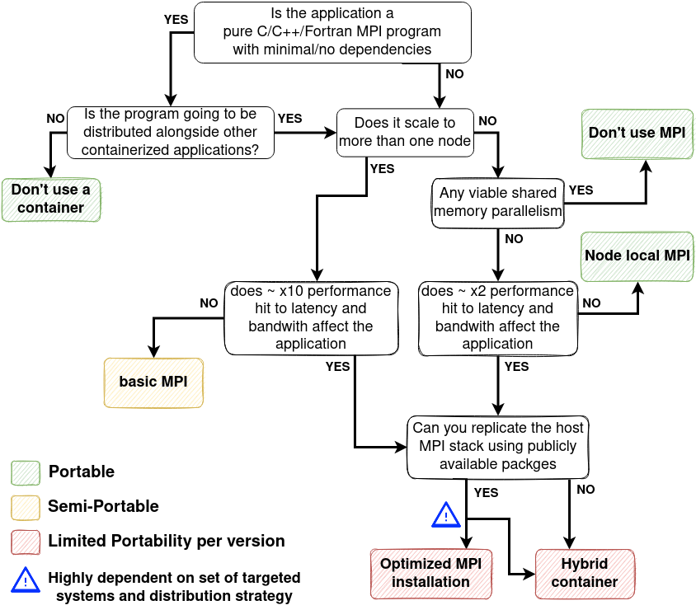
What about performance-optimized containers?
An optimized model for building the container and running it on the host machine with its libraries
Increases the performance but requires the host and container MPI are ABI-compatible, which reduces portability
Evaluate the best structure of optimized images through experience and likely frequency of updates needed, decide which libraries should be compiled and evolve the images to accommodate this.
Singularity images can be introduced to run on HPC – both adheres Open Container Initiative (OCI)
https://permedcoe.github.io/mpi-in-container/
Notes:
MPI stands for "message passing interface". It is a standardised communication library used in parallel computing.

Slide 13
IFS Performance – Host vs "Optimized MPI" container
Same exact forecast run natively and inside a container. Y-axis shows "forecast days per day". Higher is better
Container built using Singularity and an "Optimized MPI" strategy
Same MPI (OpenMPI 4.1.1)
The target machines interconnect drivers installed in the container
Runs using the containers MPI
Container ~10% slower at 128 nodes.
Is it from MPI?
Notes:
What is an "Optimised MPI" containerisation strategy?
In this strategy, we're building everything from the ground up which we need for fast MPI performance. Unfortunately, we have to sacrifice a lot (most :D) of our portability to do so. We must Install the drivers for the HPC interconnect used on the target machine and link the MPI install to those drivers. This is what we mean by "Optimised MPI".
BUT some network drivers are propritary (e.g. Slingshot drivers) and can't be installed into a container. In this case, its not possible to build an "optimised MPI" container and a "Hybrid" strategy must be used instead.
Be warned that building your own MPI from scratch might not perform as well as the MPI on the host system, which might have been heavily optimised for that system.
The container was built in layers like:
[Network stack] -> [MPI] -> [IFS dependancies] -> [IFS]
The network stack installed is OFED drivers for the Infiniband interconnect used on Atos. Also, these drivers are different for each different linux kernel version. So I made sure the linux version (RHEL 8.6) in the container was the same as on Atos. But I suspect this container wouldn’t perform well on a machine with a different linux kernel version...further reducing compatibility.
Even if it isnt so portable there are some benefits of containerisation, like having a self-contained bundle of libraries as a record of a scientific experiment
What does this graph show?
This is a 48R1 run at TCO1279 for 3 days.
It’s a strong scaling test so the total amount of work is fixed (in this case a 3-day tco1279 forecast), and the number of nodes increases. => amount of computational work per node decreases and communication becomes a relatively larger component (stressing MPI).
So the fact that the container strong scales well indicates that our containerised MPI is holding up and performing well.
Median of 3 runs

Slide 14
Where does the performance gap come from? Not MPI
The graph compares average latency for the "all-reduce" collective communication across 64 nodes. Lower is better.
MPI performance from inside the container is almost identical to host performance.
=> Performance gap coming from elsewhere
Likely from the different version of Intel's MKL used in the container
Notes:
All-reduce is a collective communication. Its akin to doing a reduce (e.g. accumulate numbers from all nodes and add them up) and then a broadcast, so that everyone has a copy of that number.
Performance is identical! Shows that it is possible to run MPI in a container without performance penalties.
The performance gap must come from elsewhere. I suspect it comes from the verison of Intel MKL I used in the container. The non-container IFS uses an older version of MKL (2021.4.0) with a performance hack on AMD CPUs. The containers MKL (2024.0.0) doesn’t have this hack anymore.
MKL or "Math Kernel Library" implements maths operations like Matrix Muls etc. Intel implements specific versions of these routines for different hardware. But the AMD kernels tend to run slower then the Intel ones even on AMD CPUS. So to get around this you could set some env vars or load some dummy libs to trick MKL into thinking you're running on Intel CPUs. But this trick was removed in the MKL 2024.0.0 and I couldn’t access an version
The big dip around 10^4 on the graph comes from changing the algorithm used.

Slide 15
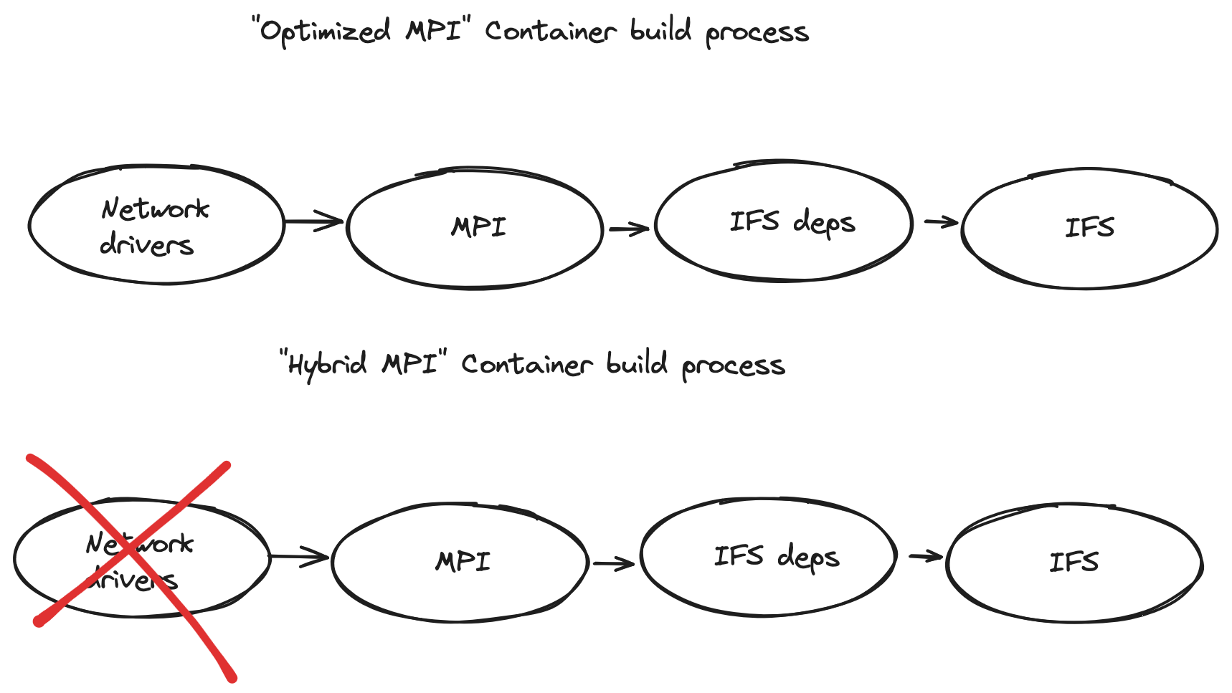
What about a "Hybrid MPI" strategy?
A "hybrid MPI" approach installs a basic MPI inside the container and uses it to build the application
At runtime, the hosts MPI is bound
into the container, overwriting the
containers version
In theory this is more portable
Container and host MPI libraries only have to be ABI compatible
No longer targeting a specific network stack
In practice finding the list of libraries to bind is difficult
But on some systems (e.g. LUMI) this bind list is made available by sys admins
Notes:
The idea behind a "hybrid MPI" containerisation strategy is we install an unoptimised MPI inside the container. We need this to build the application. Once the application is built, we can make a note of where the MPI libraries are which the application is linked against.
Then at runtime we find the corresponding libraries from the hosts optimised MPI and we can overwrite them inside the container. Something like "singularity --bind=$HOST_MPI_DIR/lib/libmpi.so:$CONT_MPI_DIR/lib/libmpi.so run ...".
But in practice its not so easy as I found out :D
Each library has its own dependancies, the MPI stack is complex and invokes up various sub different programs at runtime (e.g. PMIX for orchestrating processes across the various nodes) which also have to be bound in. On LUMI the bind list includes around 30 files or directories.
I tried it for this presentation and ended up erroring somewhere in the PMIX initialisaiton
Also, the need to bind in host libraries means that your container is no longer self-contained. An update on to something on the system (e.g. updating)/moving a library) could break the bind path.
So i

Slide 16
Thank you very much
Any Questions?

Slide 17
References and useful links
https://permedcoe.github.io/mpi-in-container/
https://docs.lumi-supercomputer.eu/runjobs/scheduled-jobs/container-jobs/
https://confluence.ecmwf.int/display/OIFS/Getting+started+on+docker

Slide 18
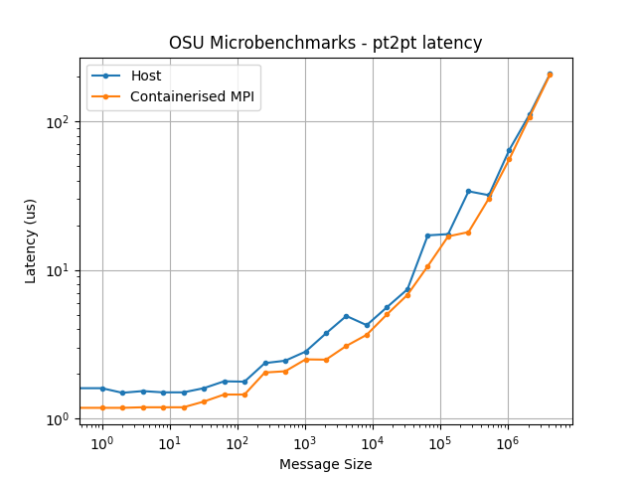
More OSU results – pt2p2 latency and BW
Lower is better
Higher is better
Identical performance from container and host MPI
Notes:
Just in case they ask, heres some more OSU results
These are more "fundamental" then the other graph. Because they show latency and BW limits between two nodes. Every other communication method will be bottlenecked by one of these numbers.
On the left is latency, this is the time to send the shortest possible message of a given size between two nodes. The right is bandwidth, or the rate at which you can send messages of increasing size.
No Idea where that weird dip on the host comes from on the BW graph.
Very unusual that, at tiny latencies, the containers OpenMPI has a slightly lower latency (~10%). The log scale overeggaxerates this difference though.

