Slide 1
EO4EU Platform
2024 IEEE International Geoscience and Remote Sensing Symposium
July 7, 2024
Speakers: Dr. Vasileios A. Baousis(ECMWF)

Slide 2




Challenges for exploiting EO data
Diverse sources of information
Data
fragmentation
Difficulty to find
and retrieve
relevant data
Lack of tools to download and
process EO data

Slide 3



















EO4EU - brief intro
EO4EU provides improved access to the EU EO data offered by a variety of platforms and data repositories.
Data sources include Copernicus services and associate platforms like the DIAS, but also upcoming initiatives like Destination Earth (DestinE)
Users interact through :
  A multi-layered user interface (GUI) for visual analytics coupled with a Workflow Editor,
  A Command Line Interface (CLI), and a respective Application Programming Interface (API),
  An extended reality (XR) interface
EO4EU Partners

Slide 4




EO4EU architectural bird's-eye view
EO4EU applications
Dashboards
API
Data processing workflows
XR
EO4EU processing infrastructure
Fusion
Semantic annotation
Compression
Knowledge management
Orchestration Language
EO sources
Copernicus: CAMS-CDS-CLMS,CMEMS
ADAM: Sentinel Satellite Missions ,Copernicus Data space
Other services & use cases :Istat.it, INSPIRE,CMCC,ECMWF NOAA

Slide 5
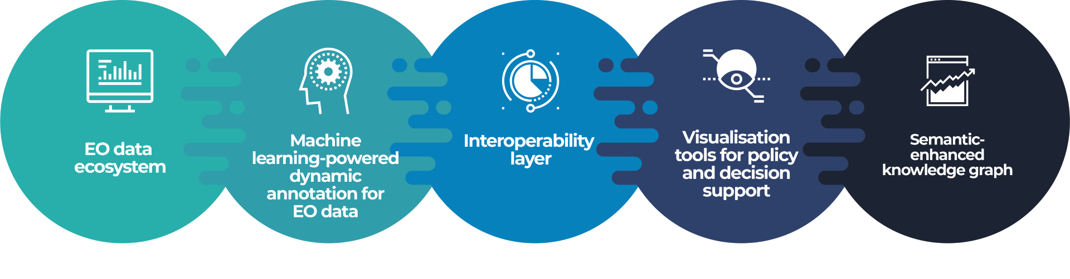
EO4EU Platform
The EO4EU Platform* allows for searching, discovering processing and analyzing EO data and is based on a series of innovative technologies which allow to:
● Access** EO data from different sources (e.g., Copernicus, Galileo, ECMWF)
● Support a sophisticated representation of data through a semantic-enhanced Knowledge Graph
● Use Machine Learning from marketplace to EO data processing
● Visualize EO data through easy-to-use graphical interfaces and Extended Reality applications
* https://www.eo4eu.eu/platform ​
** Public user access: May 2024

Slide 6
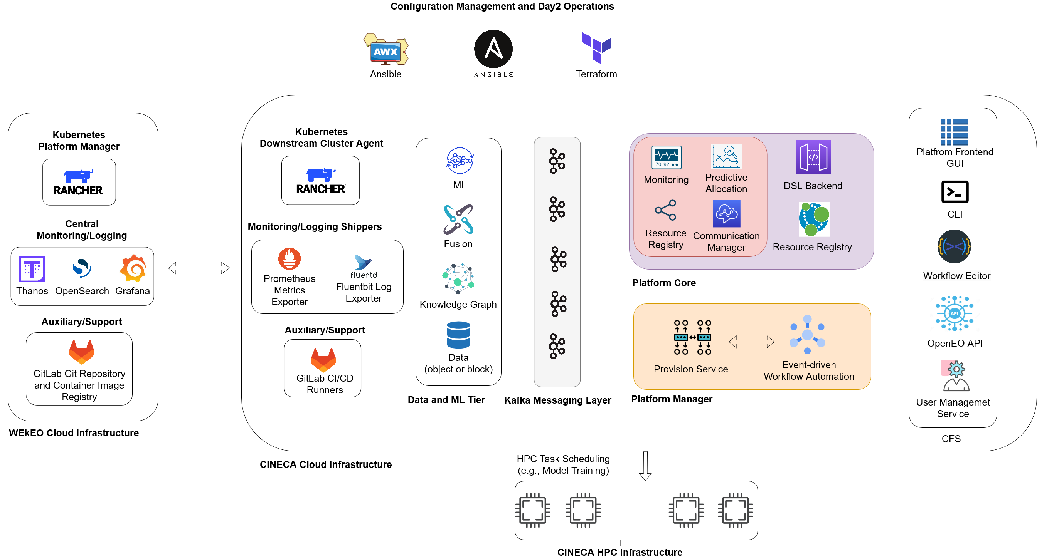
EO4EU Multi-cloud infrastructure

Slide 7






Key results
EO Data Ecosystem
Semantic Enhanced Knowledge
Graphs
Data Fusion Techniques
Dynamic Semantic Annotation and Learned Compression
Augmented/Extended Reality
Data Analytics Visualisations

Slide 8






Who benefits?
Researchers and Academia: Supports research institutions
with more accessible EO data
Policy-Makers:
Supports evidence-based policy-making and climate action
EO data providers:
Promotes further usage of EO data through value added tools
Private sector:
Encourages innovation through more accessible EO data for non-technical users
Citizens and scientists:
Enables new actions to reduce
and monitor the impact of
climate change
Standards Development Organisations: Contributes to the revision of standards related to EO data

Slide 9

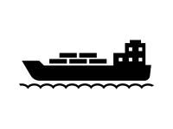






EO4EU Use Cases
EO for Personalised Health care Services: expand mobile allergy and airborne hazards forecasting
Ocean Monitoring: optimise shipping industry travel time across different oceans considering live weather data
Food Security: improve adaptability of food production using EO4EU for live climate data tracking and analysis
Forest Ecosystems: Improve forest productivity using EO4EU to simulate water, anergy and carbon fluxes
Soil Erosion: Integrate rainfall datasets through EO4EU to assess soil susceptibility to water erosion
Environmental Pests: Locust plague impact assessment and prediction
Civil Protection: Improve disaster and calamity prevention and response using EO datasets
Visit https://eo4eu.eu/use-cases

Slide 10
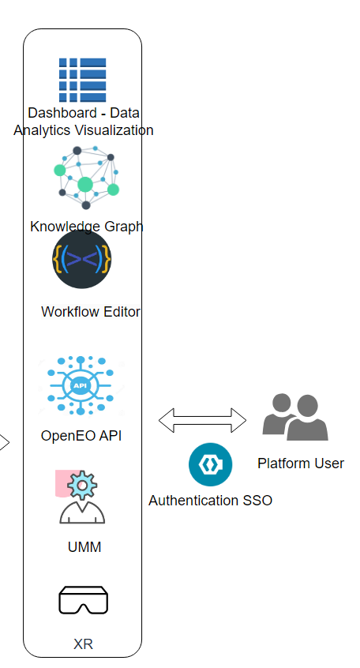
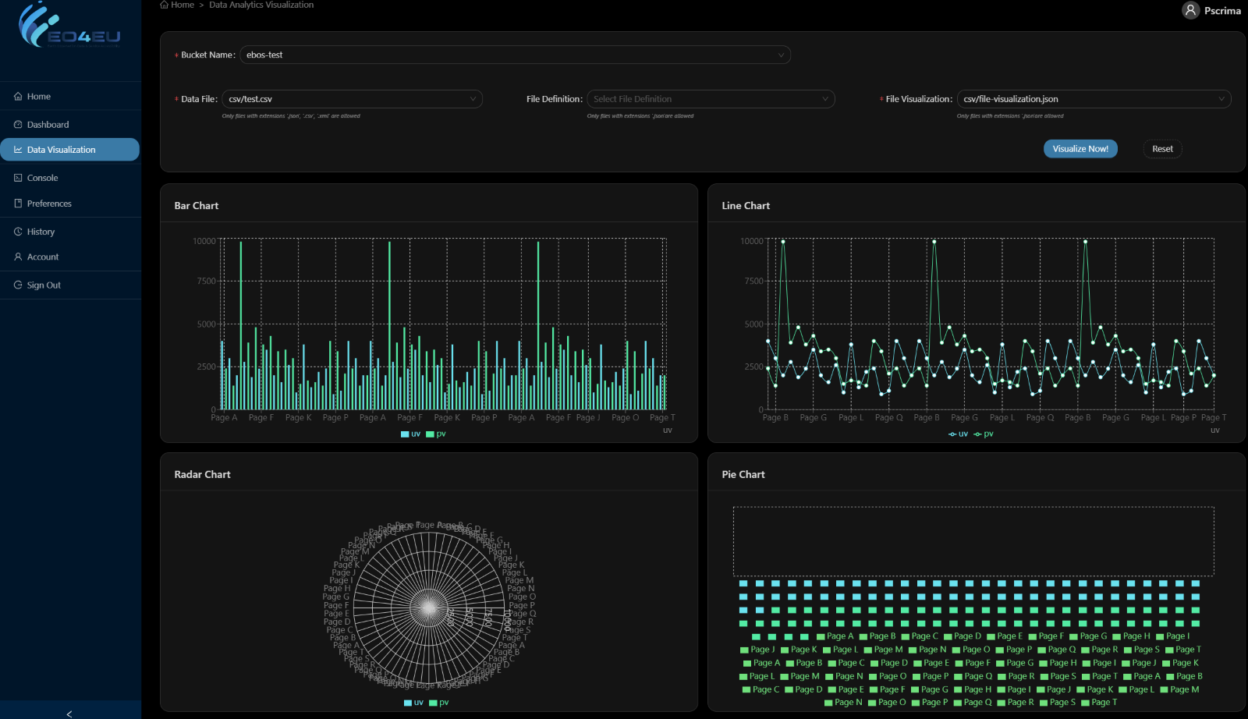
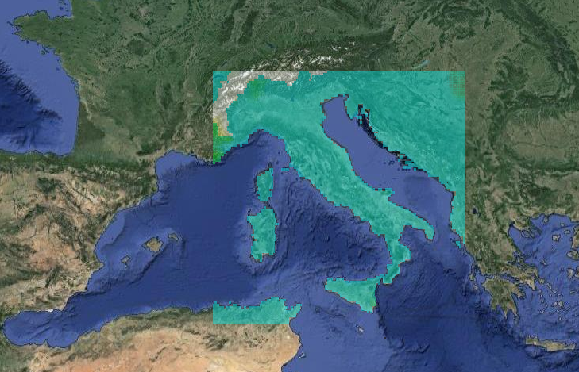
EO4EU Components – Data visualization

Slide 11
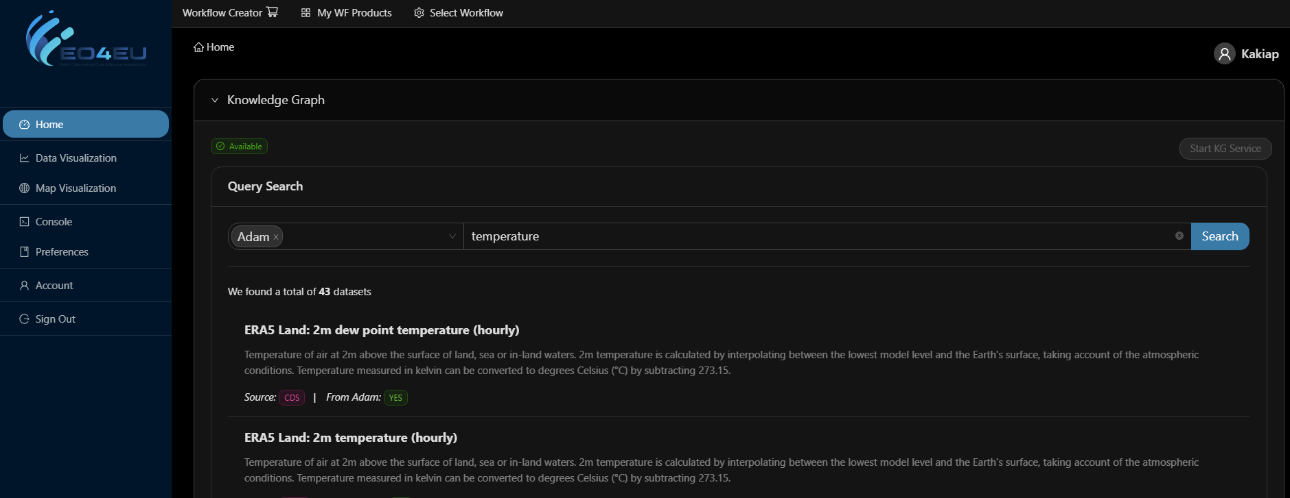
EO4EU Components – Knowledge Graph
EO4EU knowledge graph enables users to access and explore EO data and derive valuable insights.
integrates disparate datasets so that users can explore interconnected data points
enables users to locate specific information effortlessly using natural language queries

Slide 12
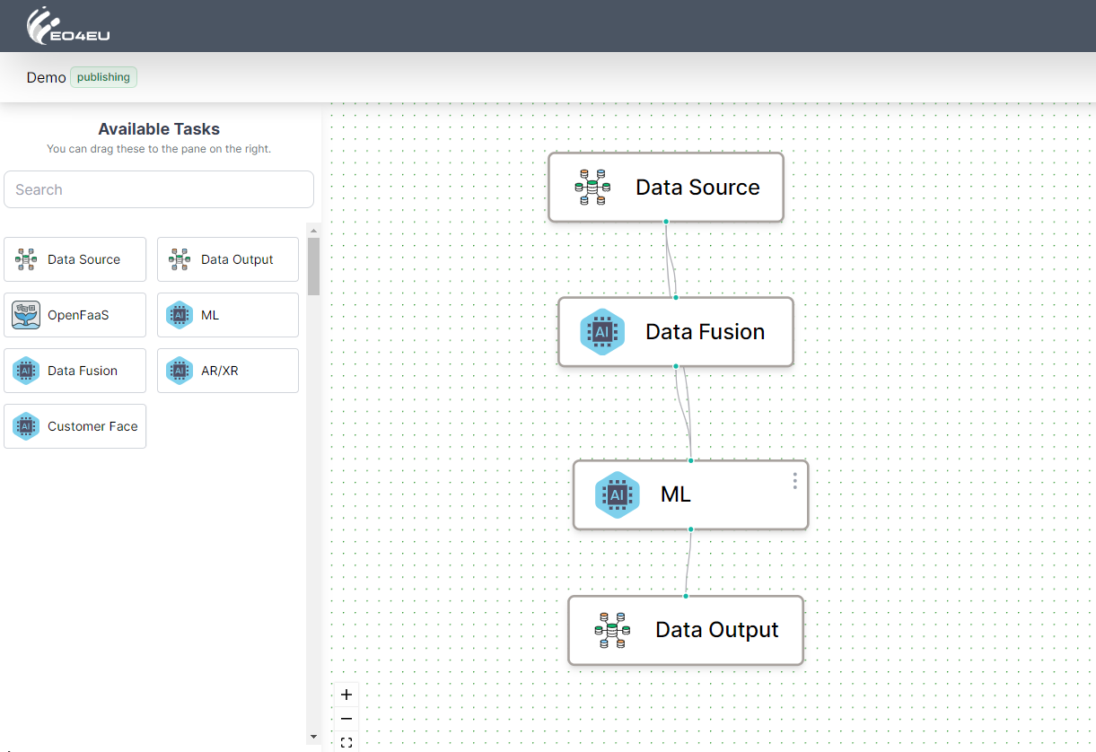
EO4EU Components – Workflow Editor
Canvas with all the available tasks represented as blocks in the left column.
User can drag & drop the block on the central canvas and connect the block using the links
Blocks can also be configured by opening the configuration form available by clicking on the menu on the top right of the block

Slide 13
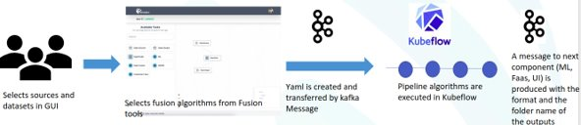
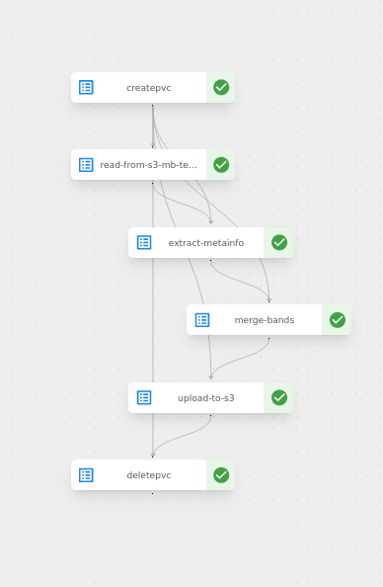
EO4EU Components – Fusion Engine
  Creates pipelines for
    Spatiotemporal processing
    Cleaning and preparation of data
  Based on Kubeflow and Python
  Messaging through Kafka
  Connection with Marketplace

Slide 14
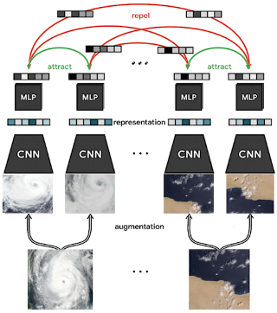
Self Supervised Learning for EO Data
EO4EU Components – Machine Learning Engine
We used contrastive learning
  to learn representations that bring close instances that should be similar
  using ConvNets and MLPs
  With EO specific augmentations,
We evaluate the learnt representations in downstream supervised tasks, land coverage.

Slide 15
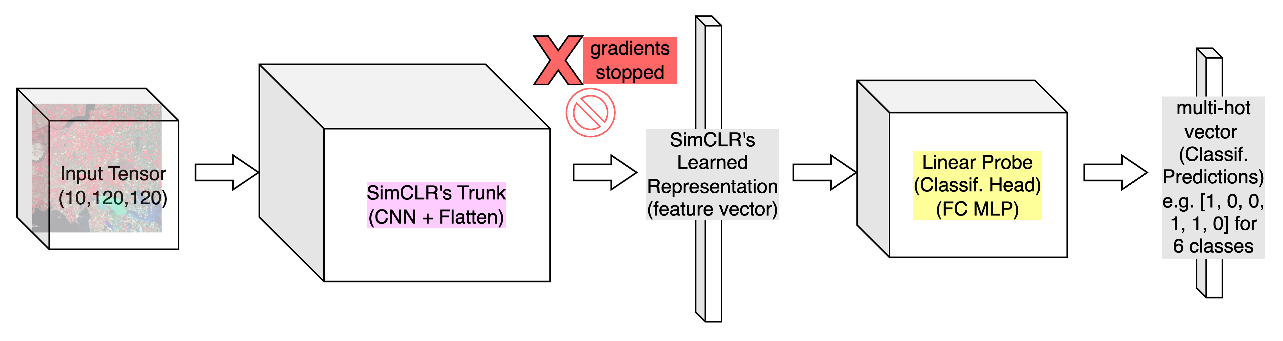
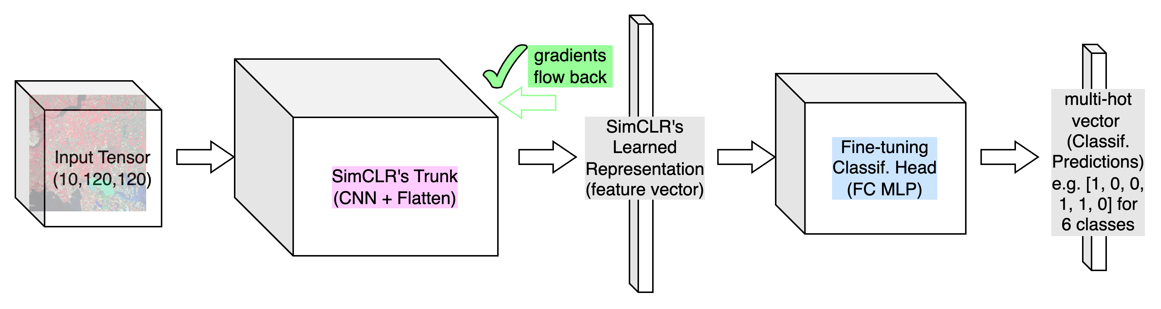
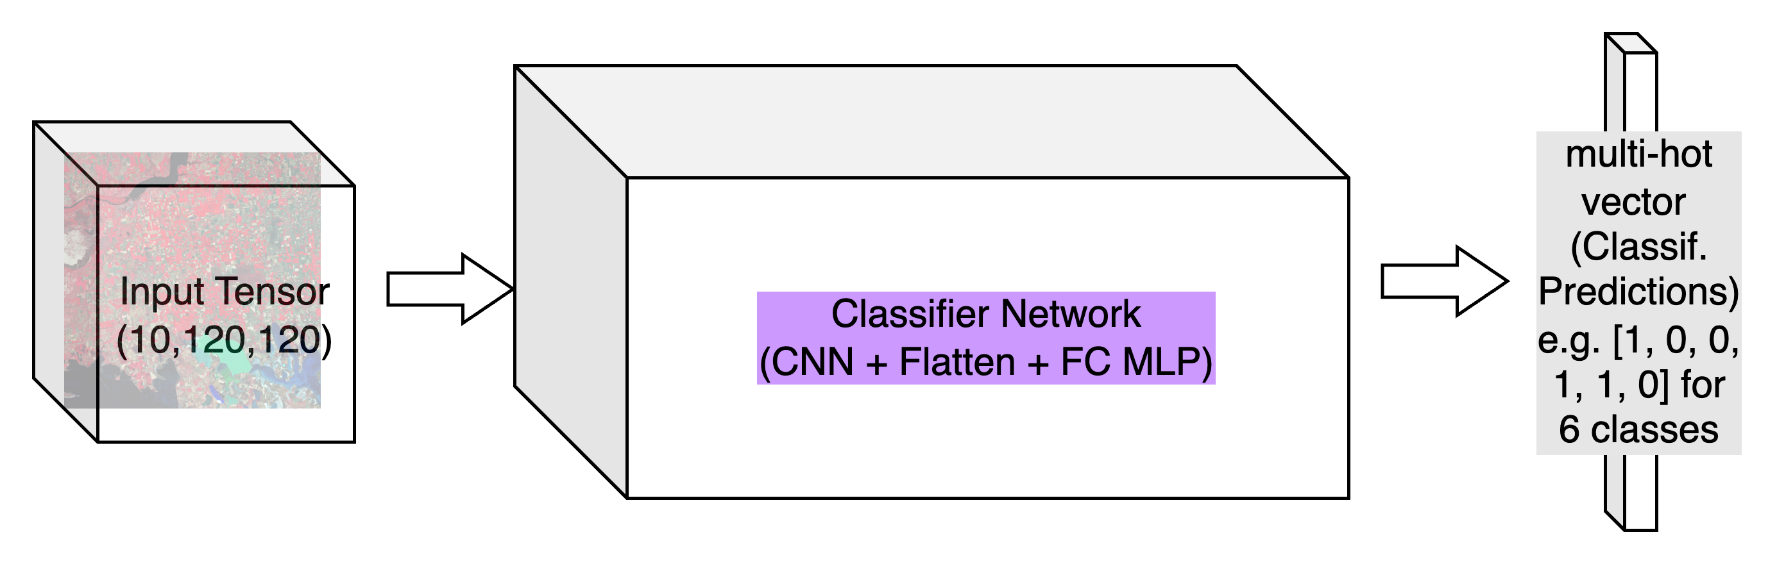
SSL models and baseline
EO4EU Components – Machine Learning Engine
SSL Model frozen, only linear prob trained on down stream annotated data
SSL Model fine tuned on down stream annotated data together with linear prob
Baseline: supervised learning model with the same architecture and number of parameters

Slide 16
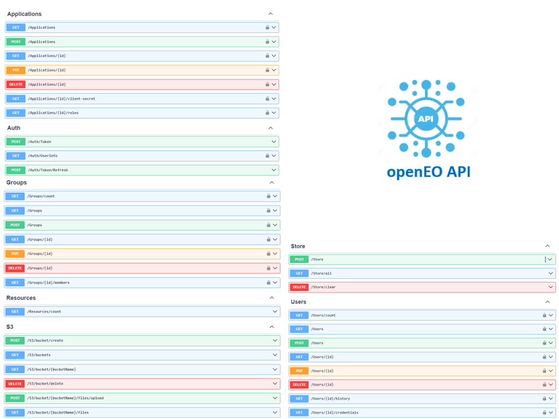
EO4EU Components – OpenEO API
External user access to the EO4EU platform using their own dashboard, using compatible OpenEO API can:
  Connect with KG
  Create/start/select aWF workflow
  Communicate with CFS components
  Access S3 bucket
  Visualize Data

Slide 17
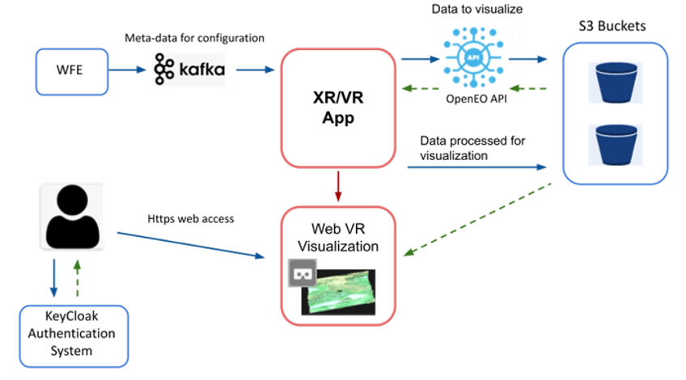
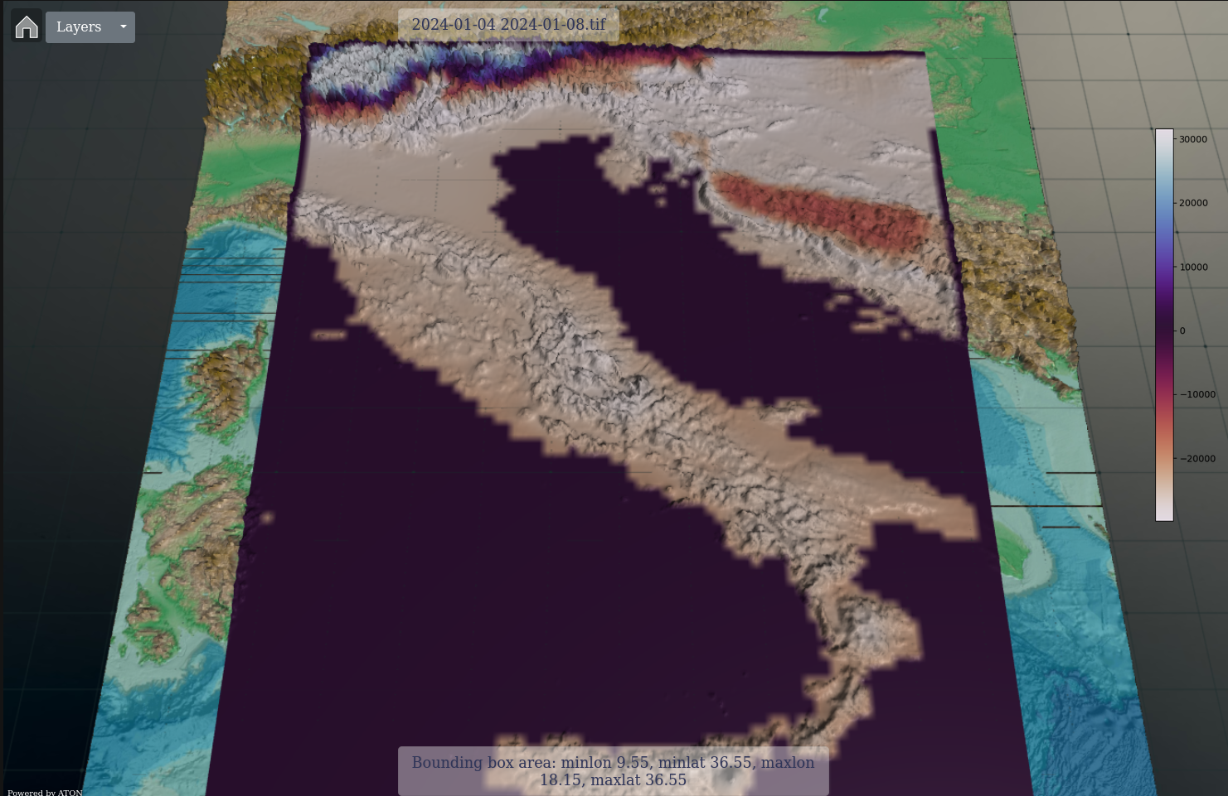
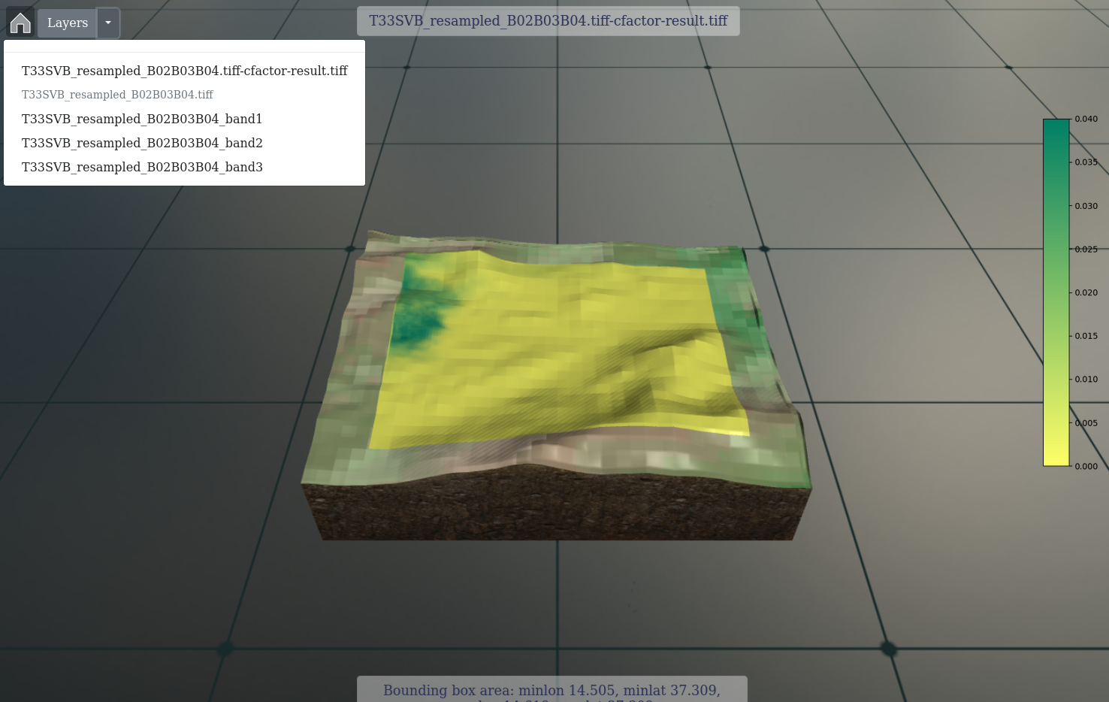
EO4EU Components – XR/VR

Slide 18
Data Tier
A set of data sources is the input of the platform. Heterogeneous data that need pre-processing with the help of a Knowledge Graph.
Data Sources​
  Interlink heterogeneous data sources (different type formats) with the EO4EU ecosystem through Open APIs (e.g. Climate Data Store API for historical occurrence of extreme weather events).​
  Access to historical and daily EO datasets.​
  Access to real time data collections streamlines (for live connections with devices and applications).​
  Access to open access cohorts of the EC through cloud-based platforms established to provide centralized access to Copernicus data, as well as to GEOSS, INSPIRE, DestinE, Galileo/ EGNOS programmes.​
  Access to open datasets and services provided by ECMWF.

Slide 19
Data Tier
Knowledge Graph-based Decision Making
  A Graph-Based Text Representation is introduced.
  This approach enables the extraction of informative features, structural or textual, for each entity related to the whole knowledge graph.
  For structure-related features, graph measures or indices such as common neighbors, preferential attachment and Adamic Adar indexing will be used.
  For text-related features, graph similarity techniques including graph neural networks and graph kernels will be used.
  By establishing a link prediction pipeline, EO4EU focuses on predicting possible relationship types between nodes of a knowledge graph.

Slide 20
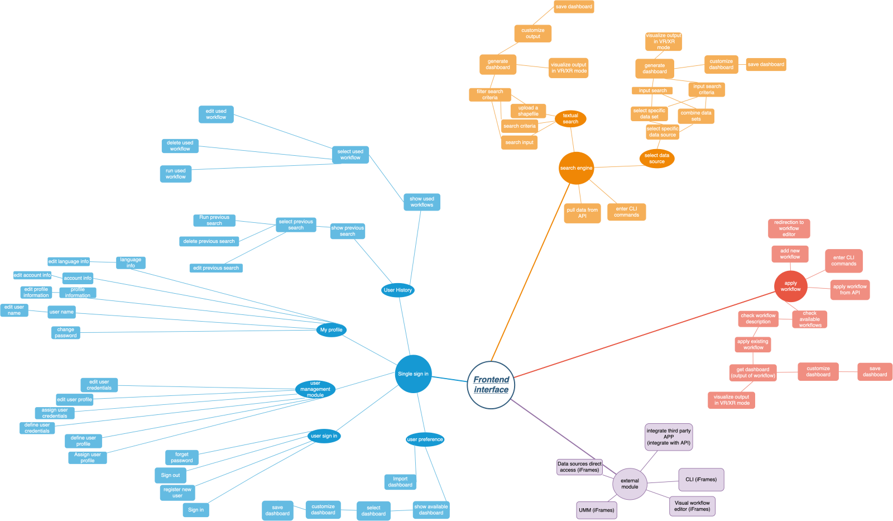
Front-end Tier - Dashboard - Data Analytics Visualization
Provides multi-dimensional User Interface-UI (Web, XR, CLI, API) that enables the user to interact and control the platform.
Decision-making and policy-maker
Real-time data analytics and interpretation of environment observations
Real-time mapping and interactions
Smart Search Engine based on Text or Annotation – Select Data - Smart Category-Type-Parameters Search Engine of the searched item
Dashboard creation
Web XR/VR Visualization methods
Data Analytics based on statistical metrics

Slide 21
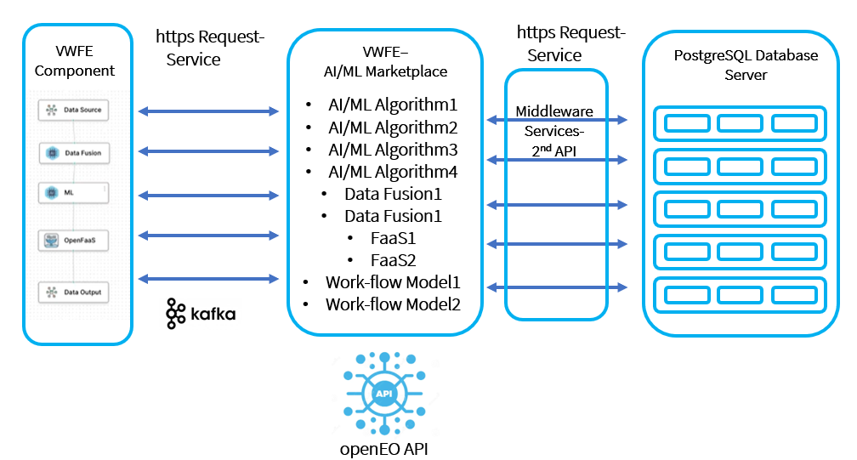
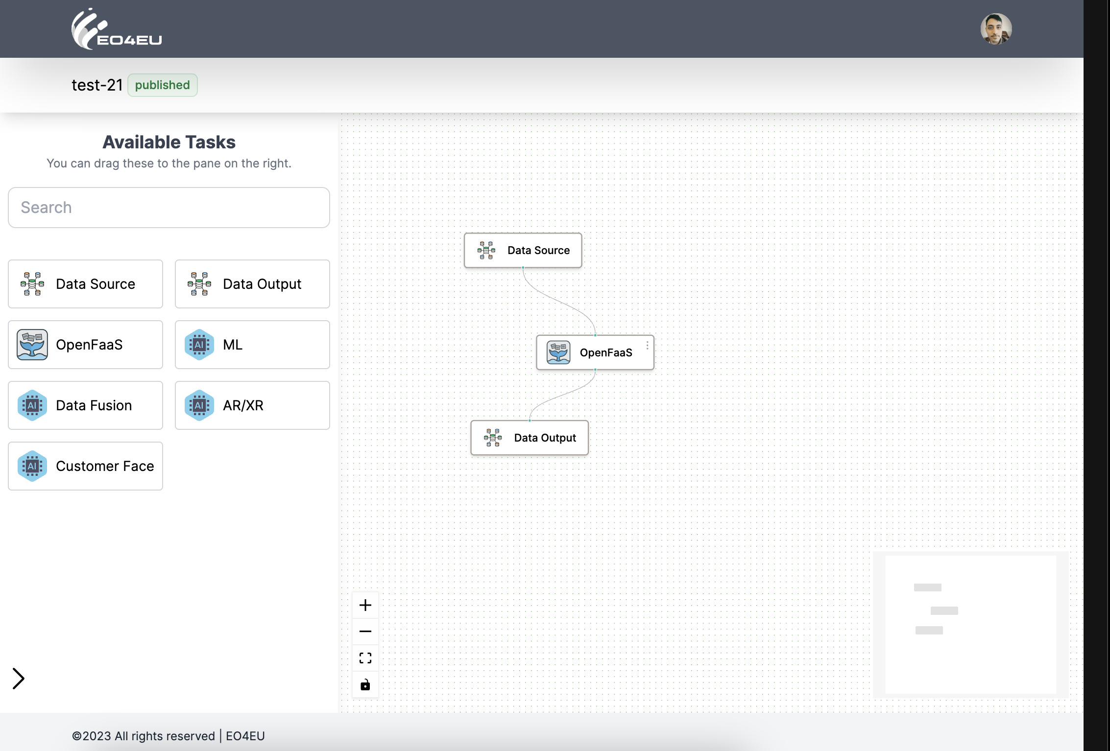
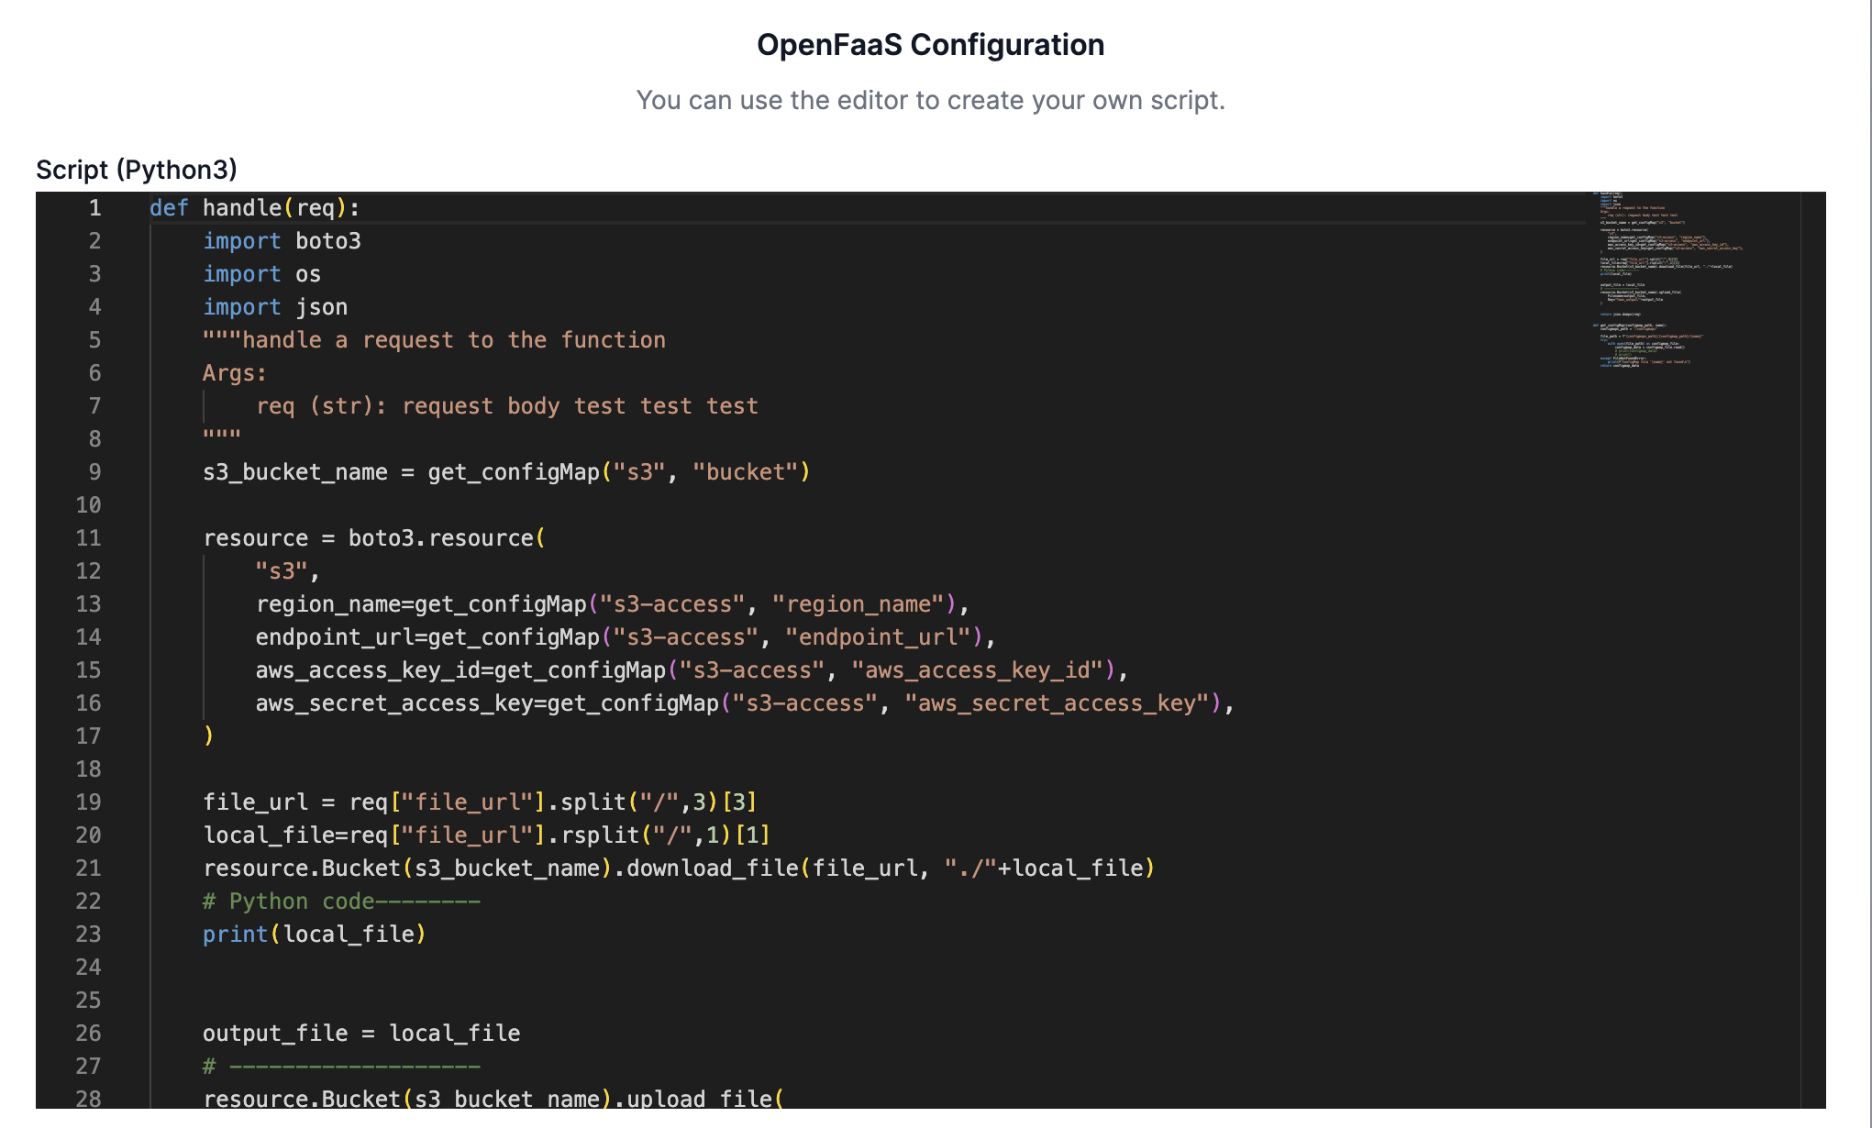
Front-end Tier - AI/ML Marketplace
AI/ML Models-Algorithms-Techniques
Metadata
Data Models for Processing and Communication from Block to Block
Programming Code
Configuration Files
Documentation
Building processing workflows

Slide 22
Building processing workflows

Slide 23
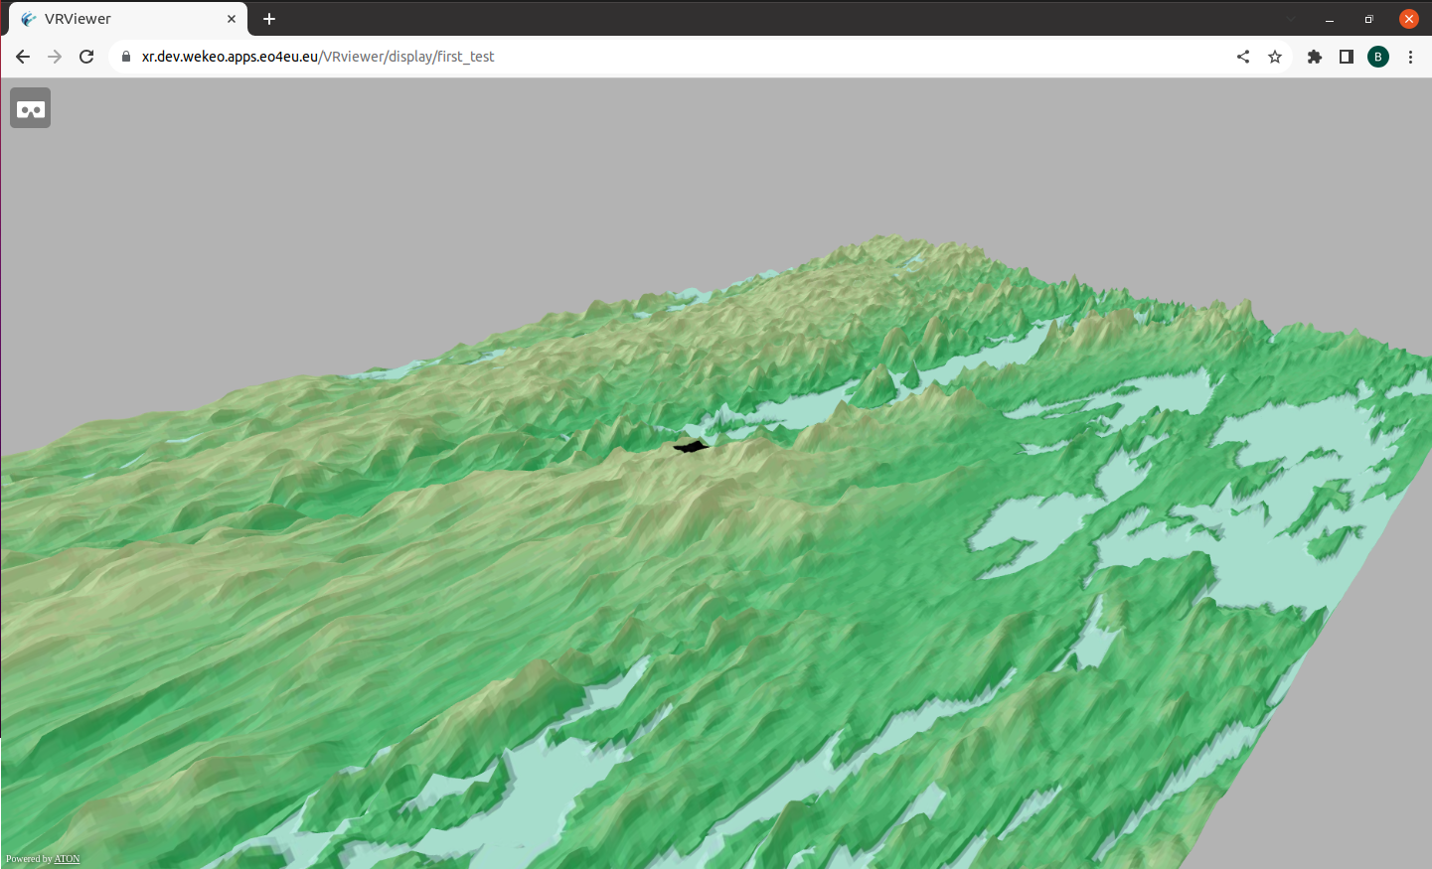
Workflow
Prepare the EO data
Download the data from S3 bucket
Reproject the data to EPSG:4326
Prepare the 3D model
Get the Digital Elevation Model
Get the texture for the context
Create a 3D model integrating the EO data, the context data and the DEM
Export and Display
Export the 3D model to GLTF
Create 3D tiles from the exported model
Display on a Webpage
https://xr.dev.wekeo.apps.eo4eu.eu/VRviewer

Slide 24
EO4EU Platform
2024 IEEE International Geoscience and Remote Sensing Symposium
July 7, 2024
Speakers: Dr. Vasileios A. Baousis(ECMWF)

