Slide 1
OEMC Global Workshop: Machine Learning tools and systems support for EO data processing and applications
Workshop contributed by the EO4EU project
Speakers: Stathes Hadjiefthymiades (NKUA), Vasileios Baousis (ECWMF), Alexandros Kalousis (HESSO)

Slide 2



















Partners

Slide 3
Rationale
Discuss how two important aspects of EO data processing platforms are being dealt with in our ongoing EO4EU project.
Platform intelligence: machine learning workflows and their components
Systems support: data processing and storage. What are the paradigms adopted for realizing processing workflows from data retrieval all the way to visualization.
Challenges: complex data requiring complex processing to obtain meaningful outputs. Scale!

Slide 4
EO4EU - brief intro
EO4EU aims to further improve access to the EU EO data offered by a variety of platforms and data repositories. Data sources include Copernicus services and associate platforms like the DIAS, but also upcoming initiatives like Destination Earth (DestinE). Without prior knowledge about their structure and format, the platform shall be able to retrieve, process, fuse and deliver new datasets, supported by machine learning algorithms and advanced semantic annotations.
An innovative ML-based learned compression algorithms shall enhance the accessibility of the data sources by reducing the respective data volumes needs to be transferred over the network, reducing the footprint of storage capacity and the network bandwidth requirements.
The control and core plane components of the EO4EU platform adapts an event-driven and microservices-based architecture, hosted on the Platform as a Service (PaaS) Tier. PaaS platforms often integrate with Kubernetes to simplify microservices development, scaling, and management.
User Experience are further enhanced with a set of visualization services and interfaces, including a multi-layered user interface (GUI) for visual analytics coupled with a Workflow Editor, a Command Line Interface (CLI), and a respective Application Programming Interface (API), and an extended reality (XR) interface to further boost the usability and the adoption of the platform, combining traditional access methods with cutting-edge technology stack
All platform communications are handled through a message-based middleware (via a Message Bus). This provides a coherent communication model with distribution, replication, reliability, availability, redundancy, backup, consistency, and services across distributed heterogeneous systems.

Slide 5




EO4EU architectural bird's-eye view
EO4EU applications
Dashboards
API
Data processing workflows
XR
EO4EU processing infrastructure
Fusion
Semantic annotation
Compression
Knowledge management
Orchestration Language
EO sources

Slide 6
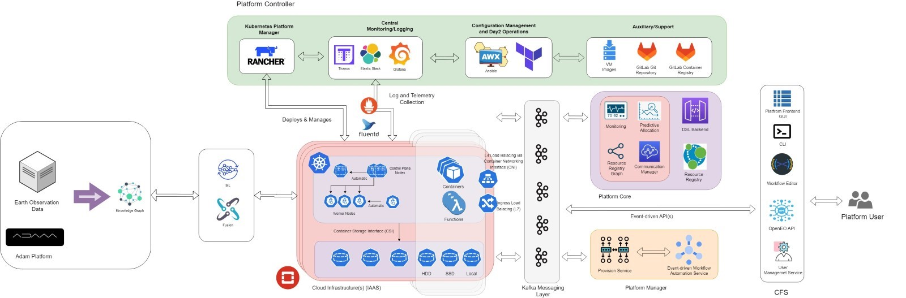
Design architecture

Slide 7
Data Tier
A set of data sources is the input of the platform. Heterogeneous data that need pre-processing with the help of a Knowledge Graph.
Data Sources​
  Interlink heterogeneous data sources (different type formats) with the EO4EU ecosystem through Open APIs (e.g. Climate Data Store API for historical occurrence of extreme weather events).​
  Access to historical and daily EO datasets.​
  Access to real time data collections streamlines (for live connections with devices and applications).​
  Access to open access cohorts of the EC through cloud-based platforms established to provide centralized access to Copernicus data, as well as to GEOSS, INSPIRE, DestinE, Galileo/ EGNOS programmes.​
  Access to open datasets and services provided by ECMWF.

Slide 8
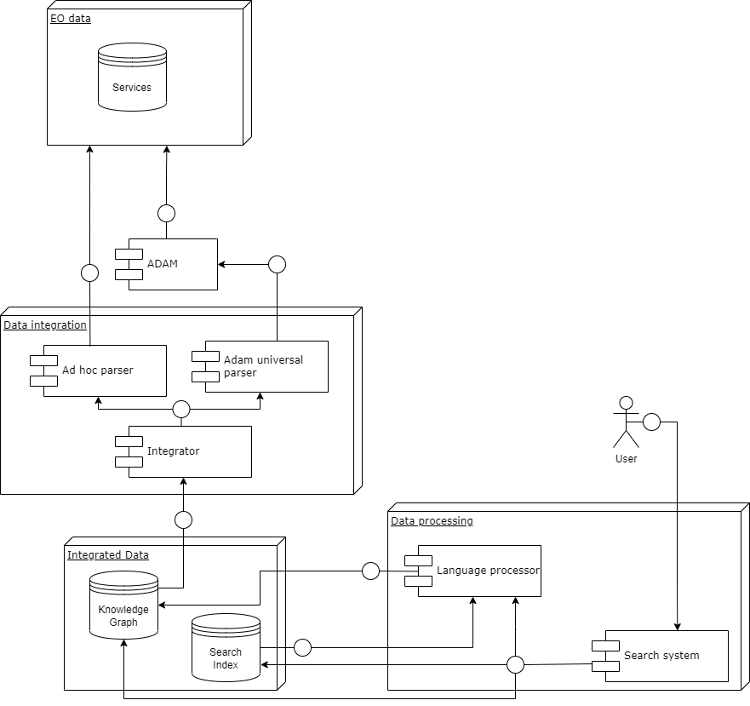
Data Tier
Knowledge Graph-based Decision Making
  A Graph-Based Text Representation is introduced.
  This approach enables the extraction of informative features, structural or textual, for each entity related to the whole knowledge graph.
  For structure-related features, graph measures or indices such as common neighbors, preferential attachment and Adamic Adar indexing will be used.
  For text-related features, graph similarity techniques including graph neural networks and graph kernels will be used.
  By establishing a link prediction pipeline, EO4EU focuses on predicting possible relationship types between nodes of a knowledge graph.

Slide 9
Machine Learning Tier
Provides all ML models in a toolbox for the post processing of the retrieved or fused data.

Slide 10
ML Tier - Fusion engine
Generic Machine Learning pipeline for semantic annotation​
  Minimize the requirement of use-case specific labelled data.​
  The Generic ML pipeline of EO4EU will enable the learning of a robust and transferable representation of the input data in a latent space, in an unsupervised way.​
  Rely on approaches such as SimCLR, which is a simple framework for contrastive learning of visual representations.​
  Explore other approaches such (e.g., Mocov2 and any potential new work in this rapidly evolving area of research). ​
  Such a representation will provide the input representation over which the downstream tasks will operate for the learning of task specific models.​

Slide 11
Front-end Tier
Provides multi-dimensional User Interface-UI (Web, XR, CLI, API) that enables the user to interact and control the platform.

Slide 12
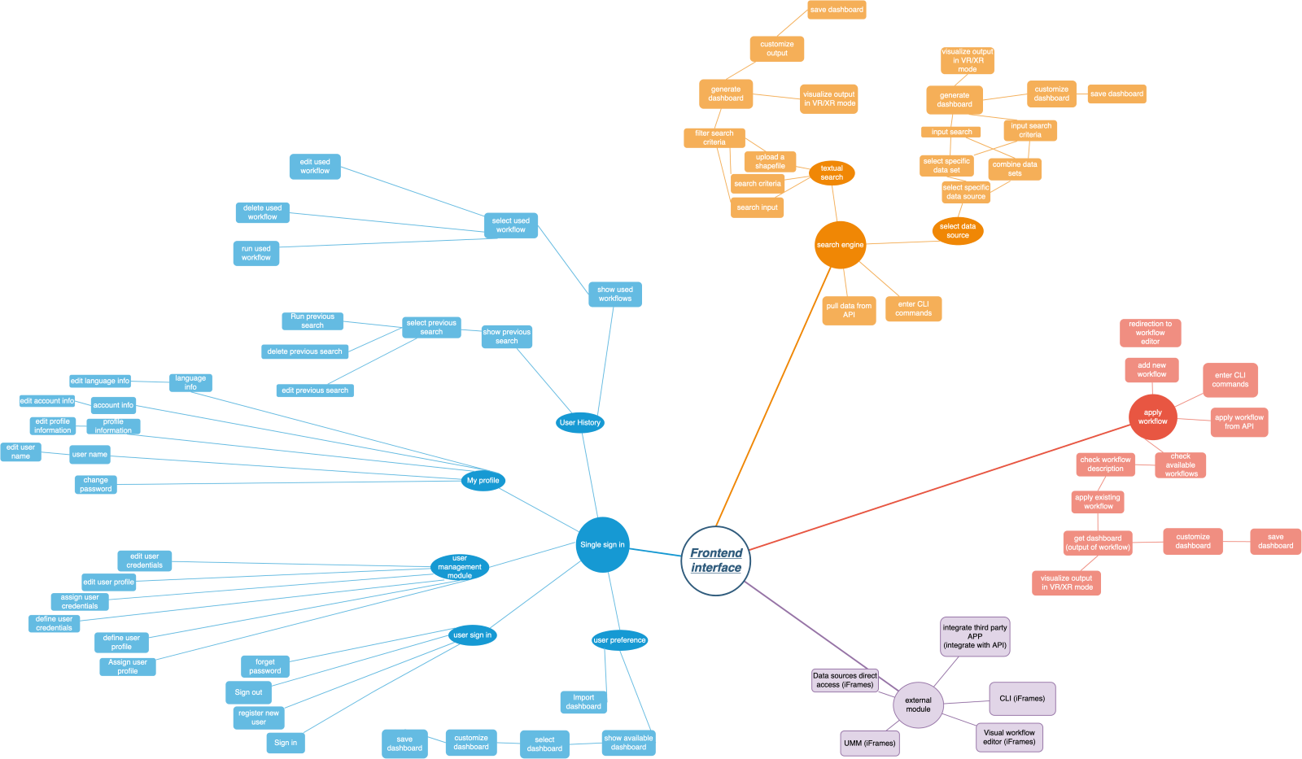
Front-end Tier - Dashboard - Data Analytics Visualization
Decision-making and policy-maker
Real-time data analytics and interpretation of environment observations
Real-time mapping and interactions
Smart Search Engine based on Text or Annotation – Select Data - Smart Category-Type-Parameters Search Engine of the searched item
Dashboard creation
Web XR/VR Visualization methods
Data Analytics based on statistical metrics

Slide 13
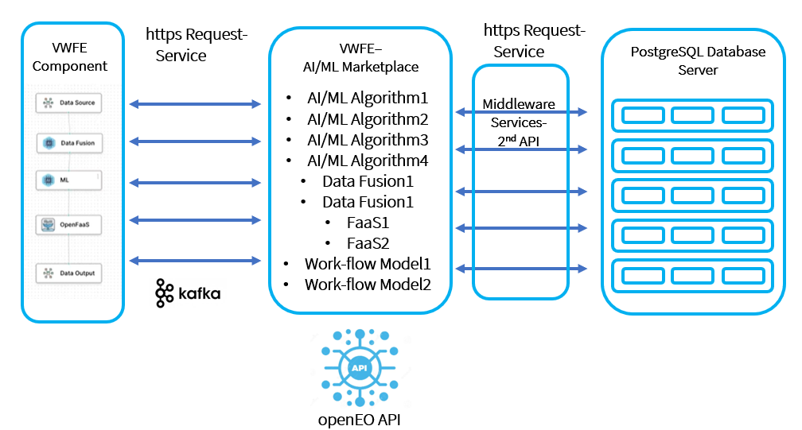
Front-end Tier - AI/ML Marketplace
AI/ML Models-Algorithms-Techniques
Metadata
Data Models for Processing and Communication from Block to Block
Programming Code
Configuration Files
Documentation

Slide 14
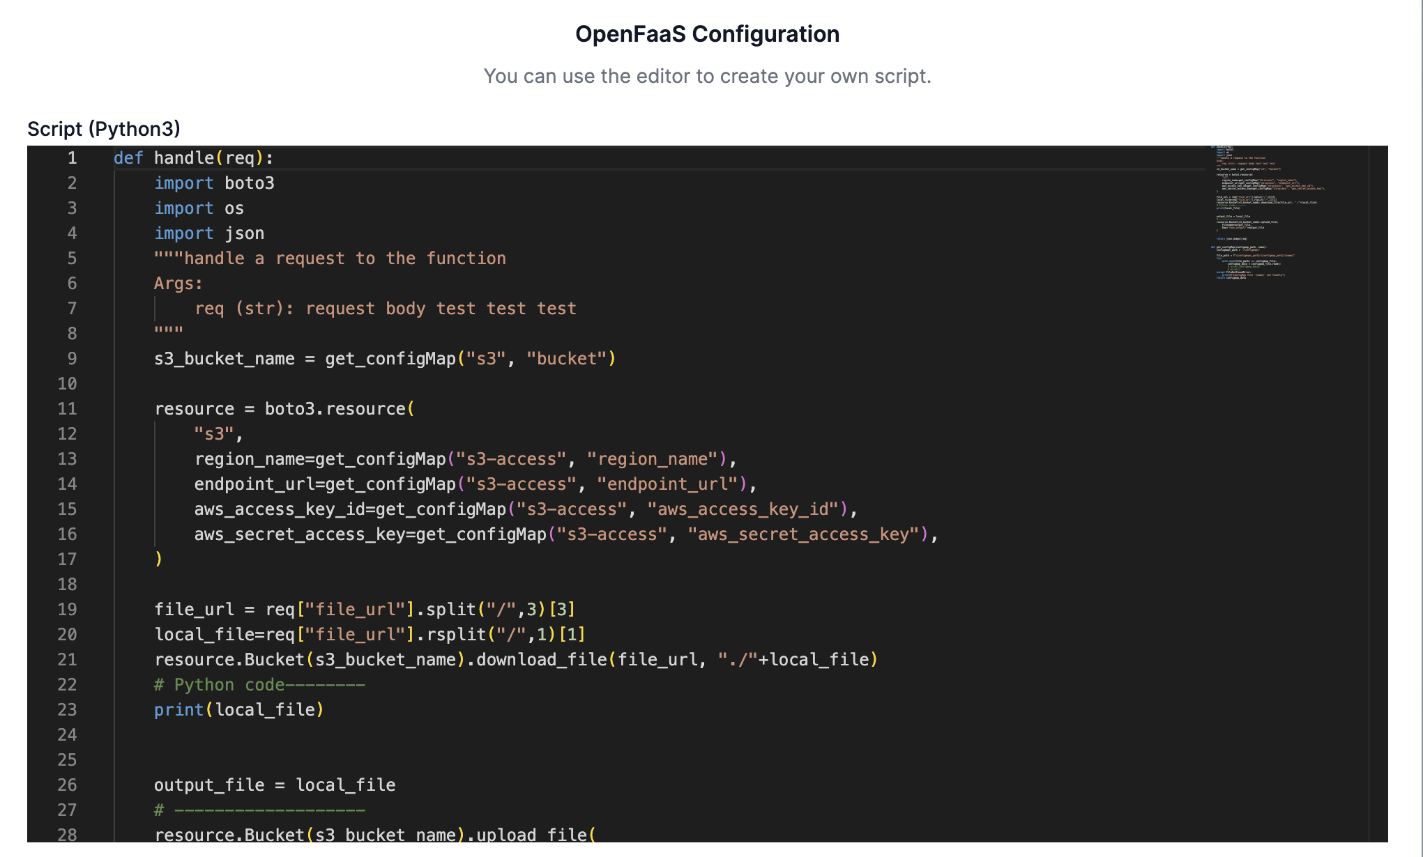
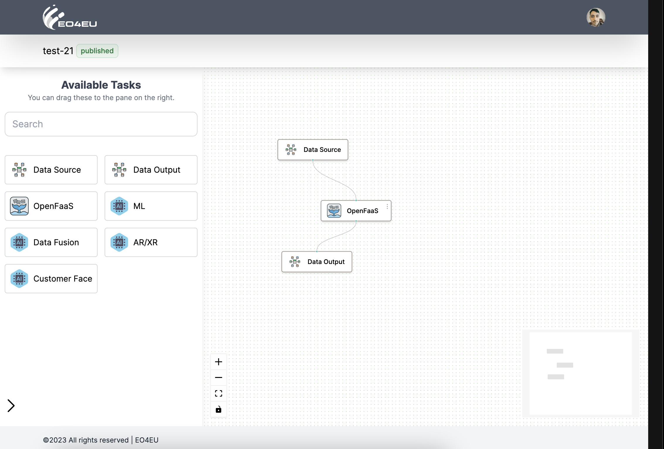
Building processing workflows

Slide 15
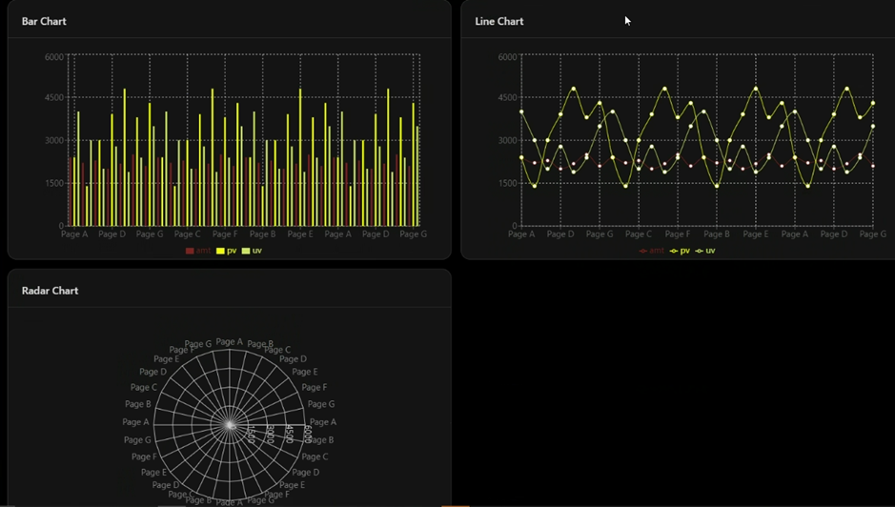
Visualization Dashboard (configurable thru the WFE) 1/2

Slide 16
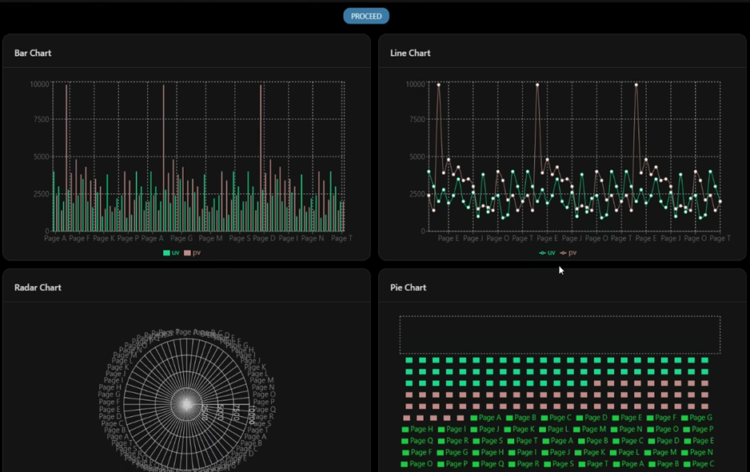
Visualization Dashboard (configurable thru the WFE) 2/2

Slide 17
EO4EU Use Cases (UCs)
#1 - EO for personalized health care services → EU to Globe, focus in Latvia, Lithuania
#2 - Ocean monitoring → Far East-N. Europe, N. Europe-S. America
#3 - Food security → Italy & other
#4 - Forest ecosystems → Austria
#5 - Soil erosion → Italy
#6 - Environmental pests → West and East Africa, Middle East, India
#7 - Improving Civ. Prot. activities → Italy (Sicily)

Slide 18

UC#1: EO for Personalized Health care Services (lead: FMI; part. VU, LU)
Expanding the capacity of the PASYFO model, the first-ever operational symptom forecasting model that includes a mobile application. The PASYFO components will be developed into full-scale working systems (TRL 8).
Input data | Spatial extent | Temporal extent
Citizen self-reported allergic symptoms for each region in Europe and the globe | Europe, a collection of individual points of citizen observations | Daily updated 1-day citizen reports
CAMS and SILAM AQ predictions | Europe: 10 km, Globe, ~20km | Daily updated operational 1-hour forecasts

Slide 19
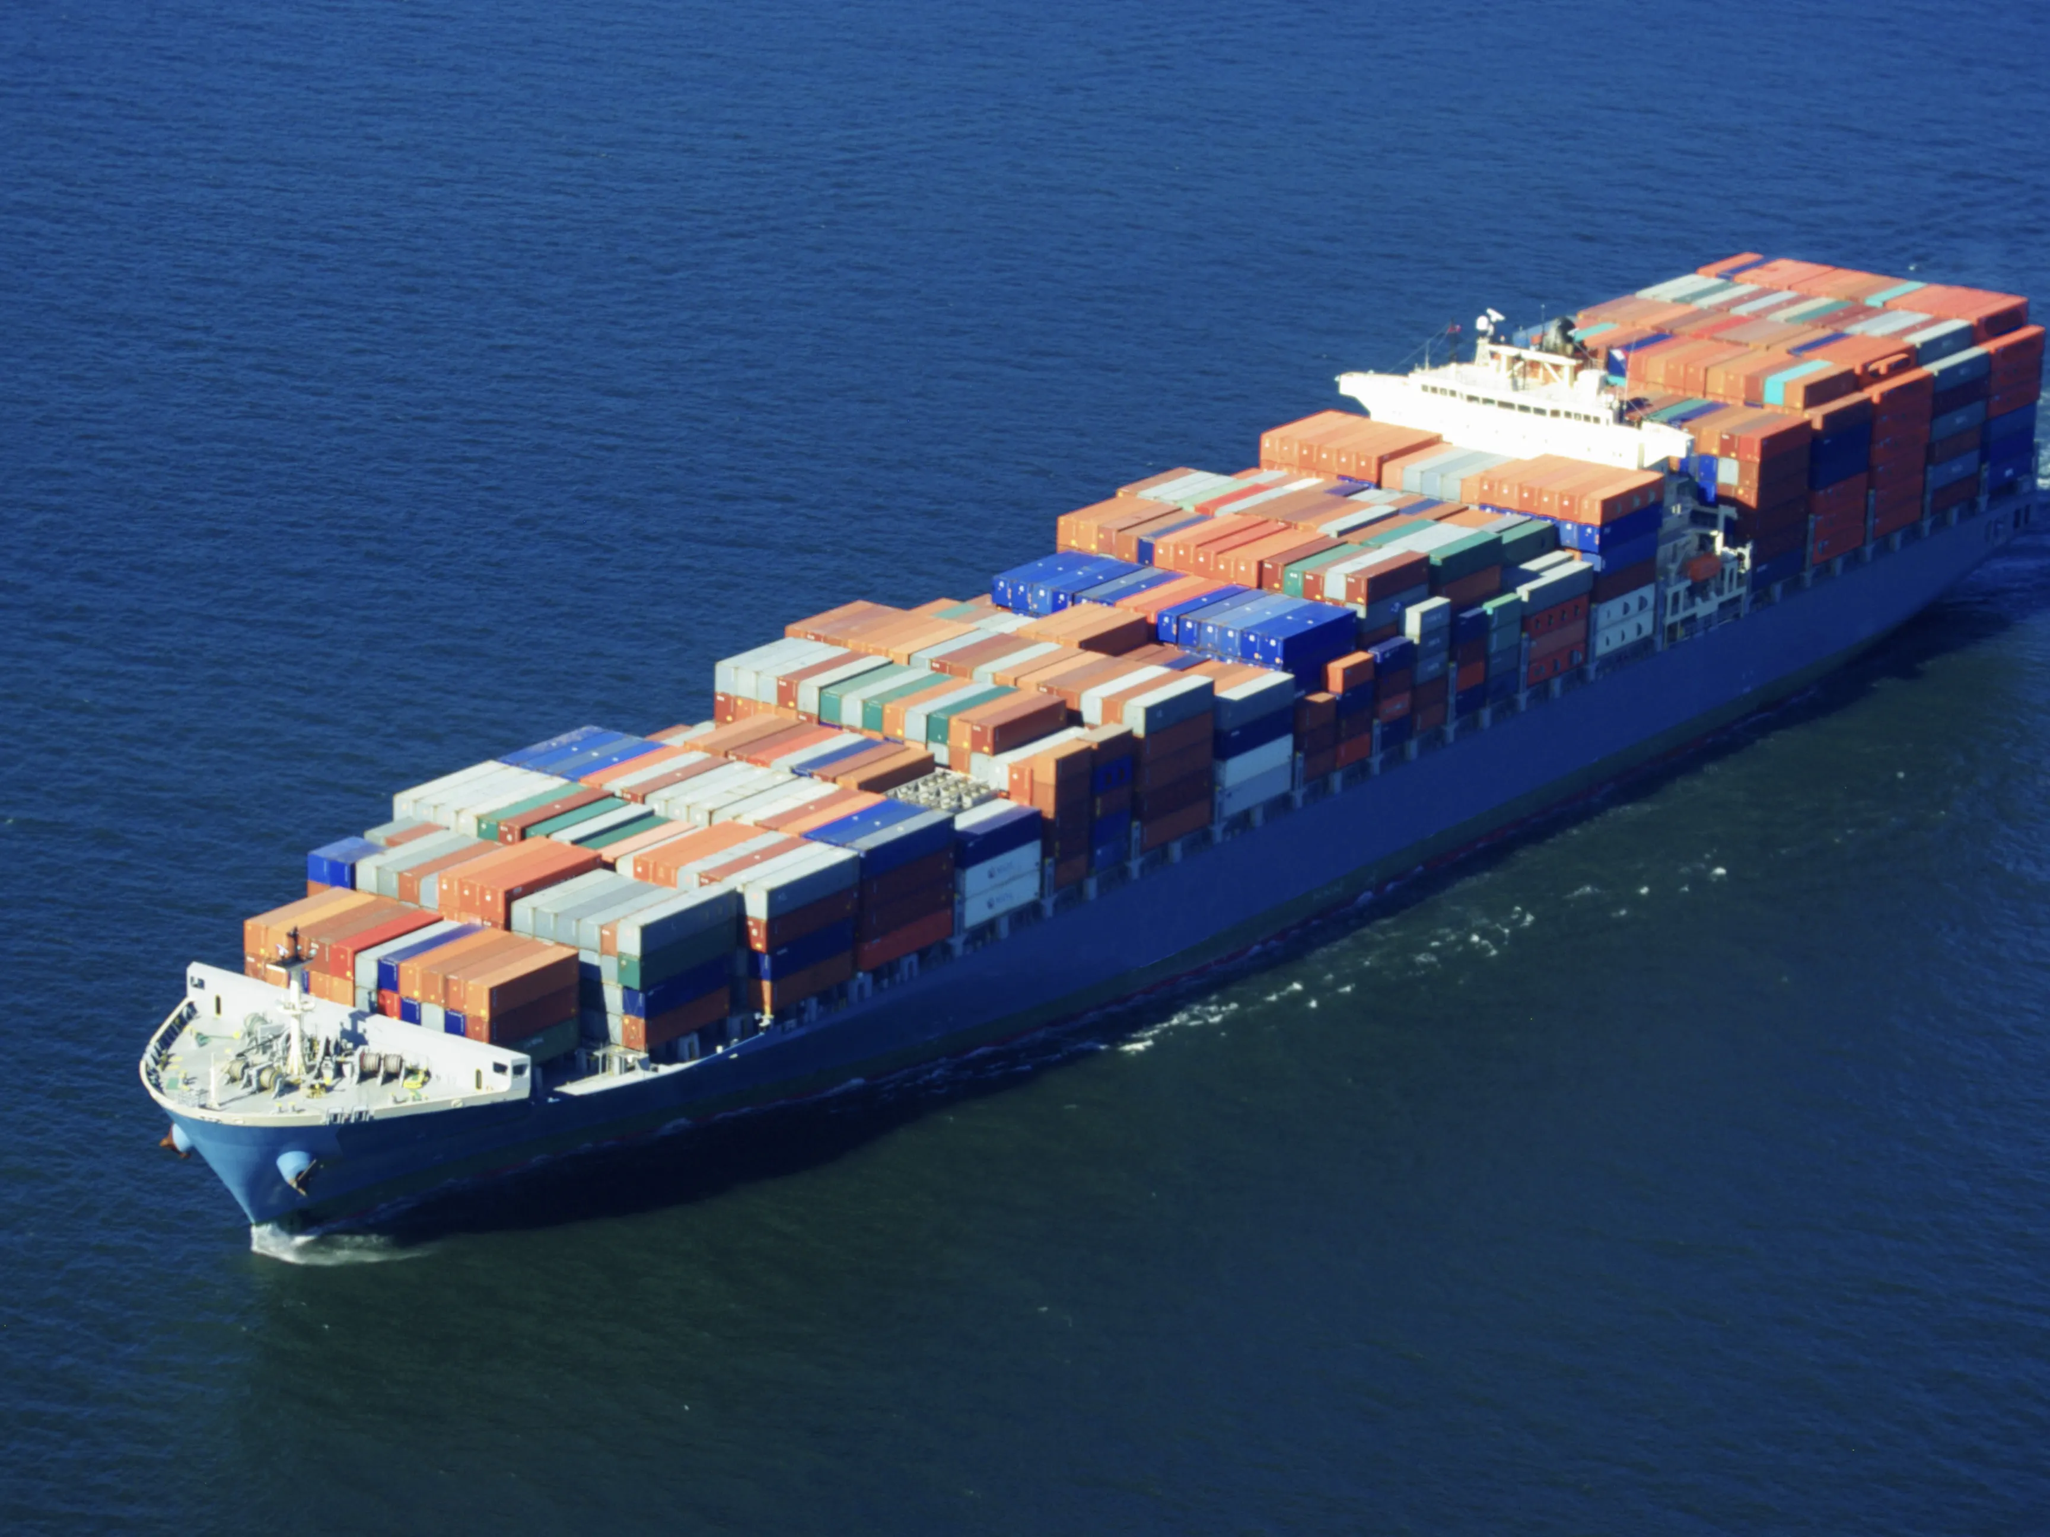
UC#2: Ocean monitoring
Enhance the quality of information and the optimization method for containerships voyages, so as to produce better analysis and plan more efficient routes in terms of fuel consumption, safety and arrival time precision.
The Use Case will demonstrate the capability of handling extreme volumes of data by fusing the meteorological data collected from EO data sources and a vessel to perform route optimization during the voyage of the ship.
EO4EU will offer enhanced visualization capacity of the data obtained both by sources as well as the in situ data, offering a multi-layer interaction with the user onboard, while augment user-friendliness and responsiveness.
Input data | Spatial extent | Temporal extent
Copernicus marine environmental monitoring service | ship routing | start of a route till the end of the route
Gallileo | ship routing | start of a route till the end of the route
Egnos | ship routing | start of a route till the end of the route
GRIB2 Weather forecast datasets | ship routing | start of a route till the end of the route
On-board sensors | ship machinery condition, fuel consumption and navigational data outputs (temperature, pressure, FOC, SFOC, SOG, STW, course, heading, etc.). | start of a route till the end of the route

Slide 20
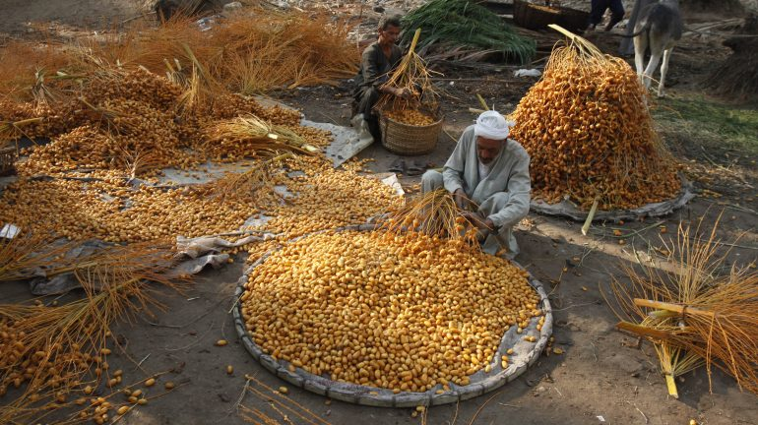
UC#3: Food Security
Impact analysis, mainly based on observation data (from ground, satellite, production and climatic time series)
Risk of loss or damage estimation, through the development of predictive algorithms, based on recent time-series, forecast data and the characterization of the impact estimates of the previous component
Identification of new areas with favorable climate conditions for specific crops
Identification of crops suitable for new climate conditions
A specific pilot service concerning the agricultural product traceability will also be included (Sicily)
Input data | Spatial extent | Temporal extent
Sentinel 2 L1C – L2A | Southern, central northern Italian regions | From 2016 to present
Sentinel 1 GRD | Southern, central northern Italian regions | From 2016 to present
Temperature, rainfall, soil moisture from climate re-analysis | Southern, central northern Italian regions | From 2016 to present
Temperature, rainfall, soil moisture from climate seasonal forecast | Southern, central northern Italian regions | From present to end of project
Crop production from statistical offices | Southern, central northern Italian regions | From 2016 to present
Crop production from produces associations | Southern, central northern Italian regions | From 2016 to present

Slide 21
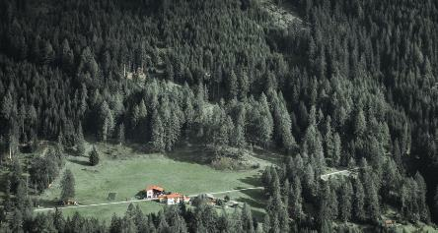
UC#4: Forest ecosystems (lead: CMCC; part. SIS)
Apply a forest ecosystem model to simulate forest ecosystem services, e.g. carbon/water use efficiency, under ensemble of climate projections and potential management, so to support smart forest management
Input data | Spatial extent | Temporal extent
LAI or NDVI indices derived from Copernicus Land Monitoring Service (CLMS) products. | Part of Austria forest land, 300m grid spacing | 2014 to 2020 (sensor PROBA-V) + 2020-present (sensor S3/OLCI), 10-days synthesis
Meteorological observations, point-based, interpolated or reanalysis (ERA5-Land or UERRA from C3S or downscaled CMCC runs) for rainfall temperature, vapour pressure deficit, radiation etc. | ≈2-9 km grid spacing for interpolated data. | Aligning to satellite data (2014-present)
EURO-CORDEX for future projections | 0.11° grid spacing | 2021-2100
Soil properties data (SOILGRIDS; ESDB raster or vector) | 250m – 1km grid spacing | Latest dataset/version available
Elevation Data (EU-DEM from Copernicus Land Monitoring Service) | 25 m grid spacing | Latest dataset/version available
Forest management plans/inventory data | Point/areal survey/field campaign data | For the latest dates available

Slide 22
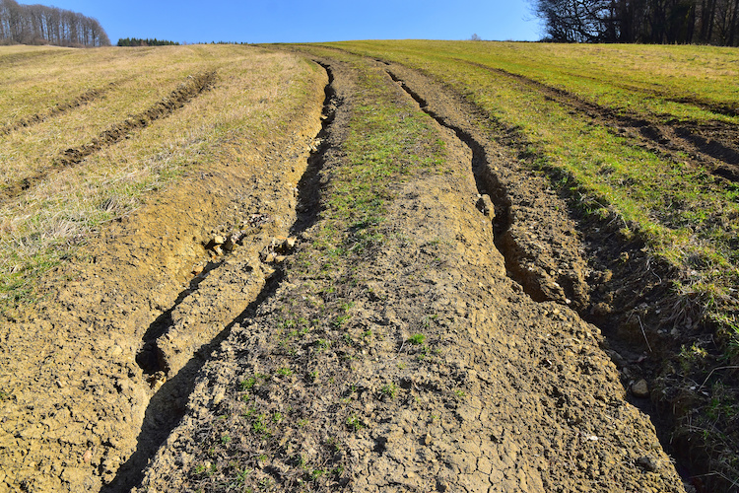
UC#5: Soil Erosion
Combine EO and model data for robust estimation of rainfall erosivity and soil loss by water-induced erosion, by advancing empirical approaches with ML methods, under ensemble of climate projections, so to support smart land management
Input data | Spatial extent | Temporal extent
Vegetation products from Copernicus Land Monitoring Service (CLMS) products. Fraction of vegetation cover Burnt Area NDVI | Italy, 300m grid spacing | 2014 to 2020 (PROBA-V) + 2020-present (S3/OLCI), 10-days synthesis
Land cover products from CLMS: Land Cover (LC) Corine Land Cover (CLC) High resolution layers (HRL) | Italy, 100m (LC, CLC) to <20 grid spacing | From 2015 to 2019, annual (LC); 1990, 2000, 2006, 2012, 108 (CLC); 2012, 2015, 2018 (HRL)
Meteorological observations, point-based, interpolated or reanalysis (ERA5-Land or UERRA from C3S or downscaled CMCC runs) for rainfall temperature, vapour pressure deficit, radiation etc. | ≈2-9 km grid spacing for interpolated data. | Aligning to land cover data (1990-present)
EURO-CORDEX | 0.11° grid spacing | 2021-2100
Soil properties data (SOILGRIDS; ESDB raster or vector) | 250 m – 1km grid spacing | Latest dataset/version available
Elevation Data (EU-DEM from Copernicus Land Monitoring Service) | 25 m grid spacing | Latest dataset/version available

Slide 23
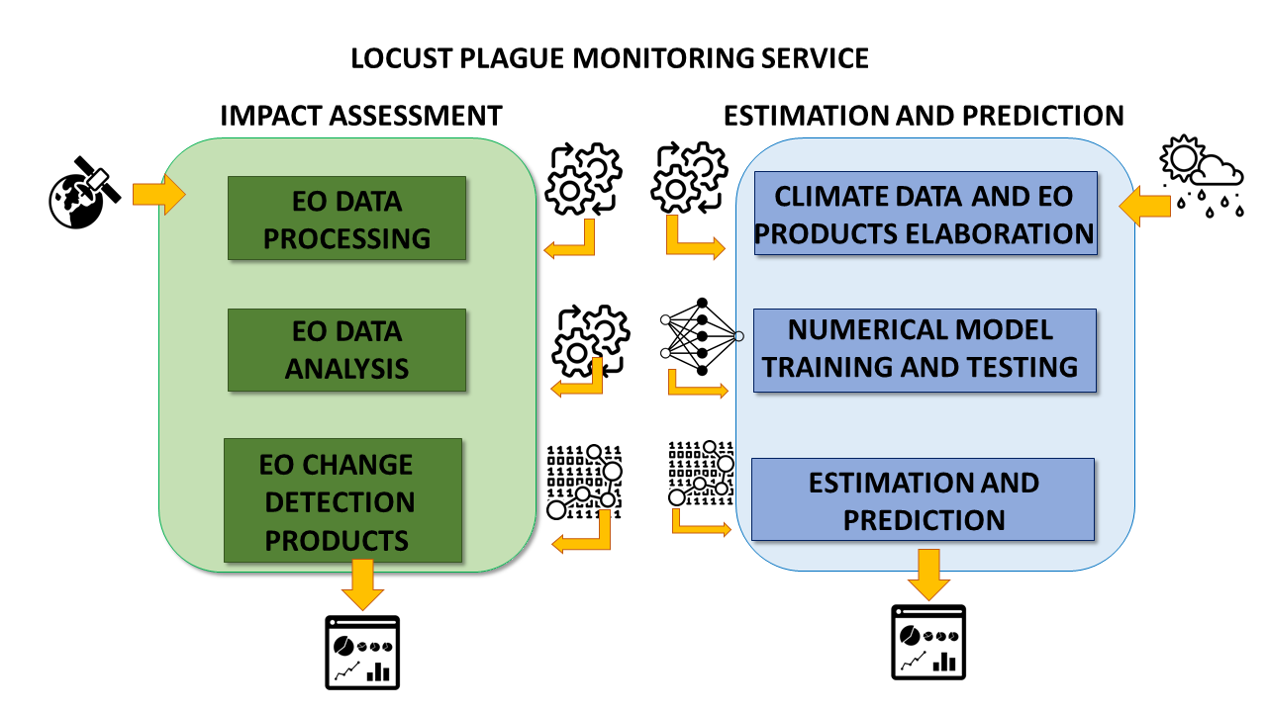
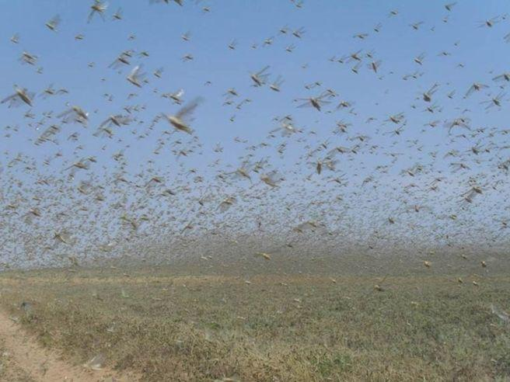
UC#6: Environmental Pests
Deliver an information service of locust plague impact assessment and prediction processing, combining together EO (esp. S1/S2) and climate data by means of AI/ML techniques
Input data | Spatial extent | Temporal extent
Sentinel 2 L1C – L2A | West and east Africa, middle east and India regions | From 2016 – to present
Sentinel 1 GRD | West and east Africa, middle east and India regions | From 2016 – to present
Locust Occurrences | West and east Africa, middle east and India regions | From 2016 – to present
Temperature, rainfall, soil moisture from climate re-analysis | West and east Africa, middle east and India regions | From 2016 – to present
Temperature, rainfall, soil moisture from climate seasonal forecast | West and east Africa, middle east and India regions | From present to end of project

Slide 24
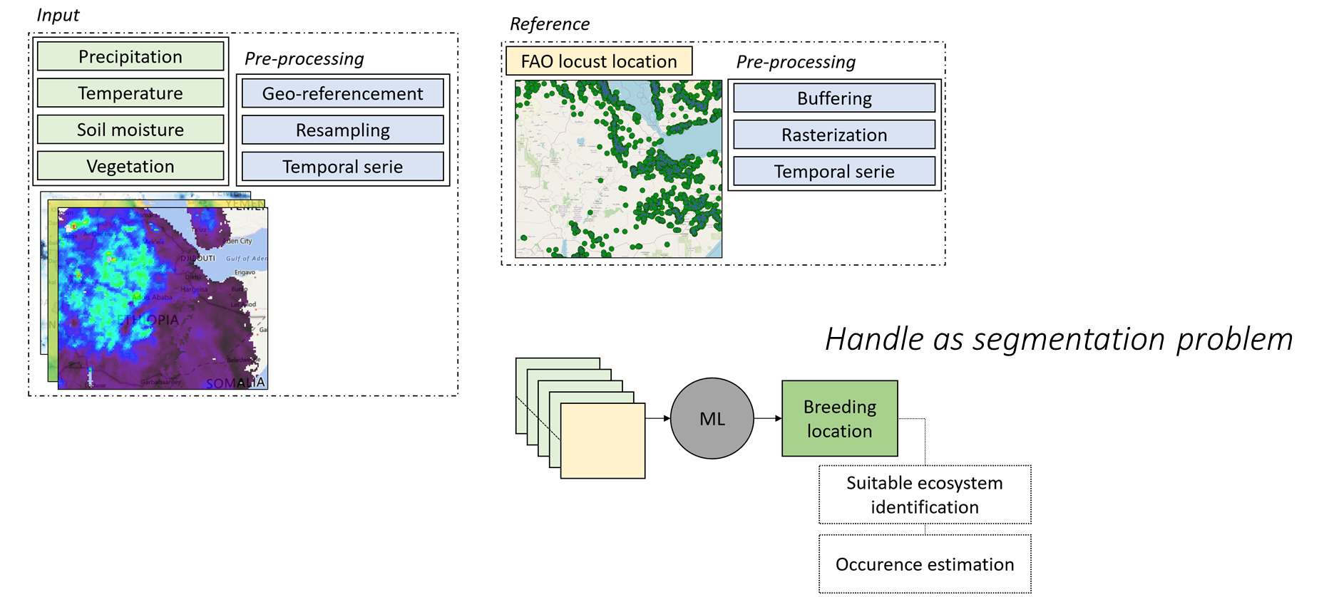
#6 - Environmental pests

Slide 25
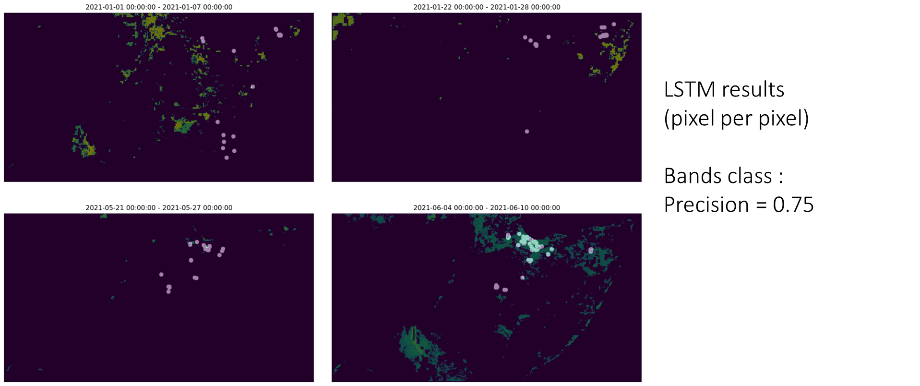
#6 - Environmental pests

Slide 26
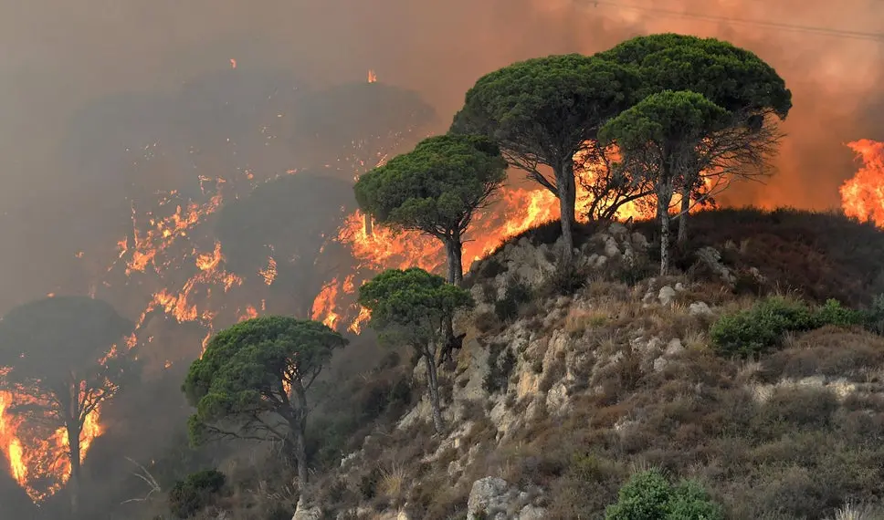
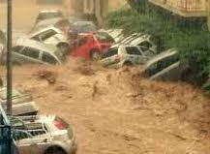
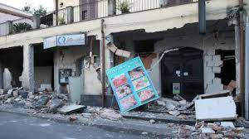
UC#7: Improving Civil Protection activities
Better exploitation and use of EU observed datasets to be used in all phases of Civil Protection operations, with focus in for wildfires and earthquakes
Input data | Spatial extent/ Resolution | Temporal extent/ Refresh
Copernicus Sentinel-2A/-2B L1C L2A | 30,000 km², 12 tiles/10m-20m | M16-M35/average 10-day repeat
Copernicus CSCDA VHR1 VHR2 | 1,600 km²/1¸4m | upon alert alert/only short term (1-3 days)
Planet Dove (Flocks) 2-4 | 10,000 km²/3.7m | upon earthquake alert /vs. monthly mosaic
Eumetsat METOP LSA-SAF ENDV110v2 | same as above/1.0 km | M16-M35/10-Day integration
Eumetsat MSG LSA-SAF FRM | same as above/3.3 km | M16-M35/ Daily + 24/48/72h
Sicily CTR (Regional Technical Chart) | same as above/10m | Static, latest update (curr. 2018, exp. 2023)
Sicily Fire Danger (Regional Forest Corps) | same as above/1.0km | Static, latest update (curr. 2020, yearly update on ex-post basis)

Slide 27
Platform usage – steps
Work Flow Editor (WFE) is a design and configuration tool for the EO4EU platform. The purpose of the tool is to create parameterize personalized data processing workflows in terms of the components that the user wishes to include in the process and in the individual parameters that need to be entered at the component level.
The design of a workflow follows the design logic of a single-path graph.
In the graph, the components are presented as nodes and the edges represent the flow of information from the output to the input of the next node.
The user, starting from the input node, which contains as meta-information the result from the user's query to the KG, places the available components in suffix order.
As terminal nodes it can use some of the available for presentation of the results such as graphs or AR/XR representation tools.
The provision-manager, after receiving the workflow design (through Kafka), will begin the validation controls to examine the deployability of the flow.
A long cycle of definition provides to the cluster the needed information for the independence of the flow.
Unique IDs provided as reference names of the cluster objects and the UUID of the namespace are the single point of true for the pipeline.
Before any deployment the provision-service executes a CI/CD pipeline request to the EO4EU GitLab creating this way the new imported function for the FaaS (serverless) instance.
Leveraging the monitor capabilities of the pipeline process (build, push to registry) as soon as the process ends, provision service will send the deployment yaml to the cluster.

Slide 28
Platform usage – steps
One deployment after another will begin to instantiate providing the ingredients for the flow. Core components is the pre-processor that downloads the datasets according to the request script provided by the KG. These datasets stored in a uniquely created S3 bucket for the workflow are now available for further processing.
The Fusion Engine implementing in a dynamic manner the A algorithm will provide in a separate S3 folder new refined products.
Subsequently, the ML engine will take over in processing the data, providing a meaningful output (based on user requirements).
In the end of the data processing cycle, a FaaS function is already deployed to the cluster and waits to micro-process according to user's needs. Serverless functionality directly communicating with the S3 stored data providing speed process on demand without wasting resources. Finally, the post-processor will seek the non image information to add them in the workflow ELS instance making aggregation and visualization process of the front-end easy.
Finally, the user is now able to:
Produce valuable data visualizations (charts, graphs, pies, GIS like view of the data etc) and validate the quality of the produced data.
Use this data to create a new workflow with his/her data.
If the eo4eu CLI/API produced data can be directly injected in the downstream applications

Slide 29






Fusion Engine
  Data processing models are combined through the fusion engine subject to the control of the Domain Specific Language (DSL).
WFE
kafka
kafka
Users
yaml
Fusion Models

Slide 30
A fusion model
Is published in a AI/ML marketplace with the following attributes
  Icon
  Name
  Input – what input format is expected
  Output – what output format is generated
  Functionality description
Is created as a Kubeflow pipeline and saved to be executed
A message to next component (ML, Faas, UI) is produced with the format and the folder name of the outputs
Yaml is created and transferred by kafka Message
Pipeline algorithms are executed in Kubeflow
Selects sources and datasets in GUI
Selects fusion algorithms from Fusion tools

Slide 31
A fusion model
Fusion is agnostic about the previous and the next workflow component. Topics are generated based on systems instructions dynamically
Is published in a AI/ML marketplace with the following attributes
  Icon
  Name
  Input – what input format is expected
  Output – what output format is generated
  Functionality description
Fusion Proxy
Creates instance and be connected to namespace
creates consumer for previous component
Executes workflow
Saves output
Creates a producer to send message to next component
User 1
Creates instance and be connected to namespace
creates consumer for previous component
Executes workflow
Saves output
Creates a producer to send message to next component
User 2
Creates instance and be connected to namespace
creates consumer for previous component
Executes workflow
Saves output
Creates a producer to send message to next component
New message with a user workflow
.
.
.
User N

Slide 32
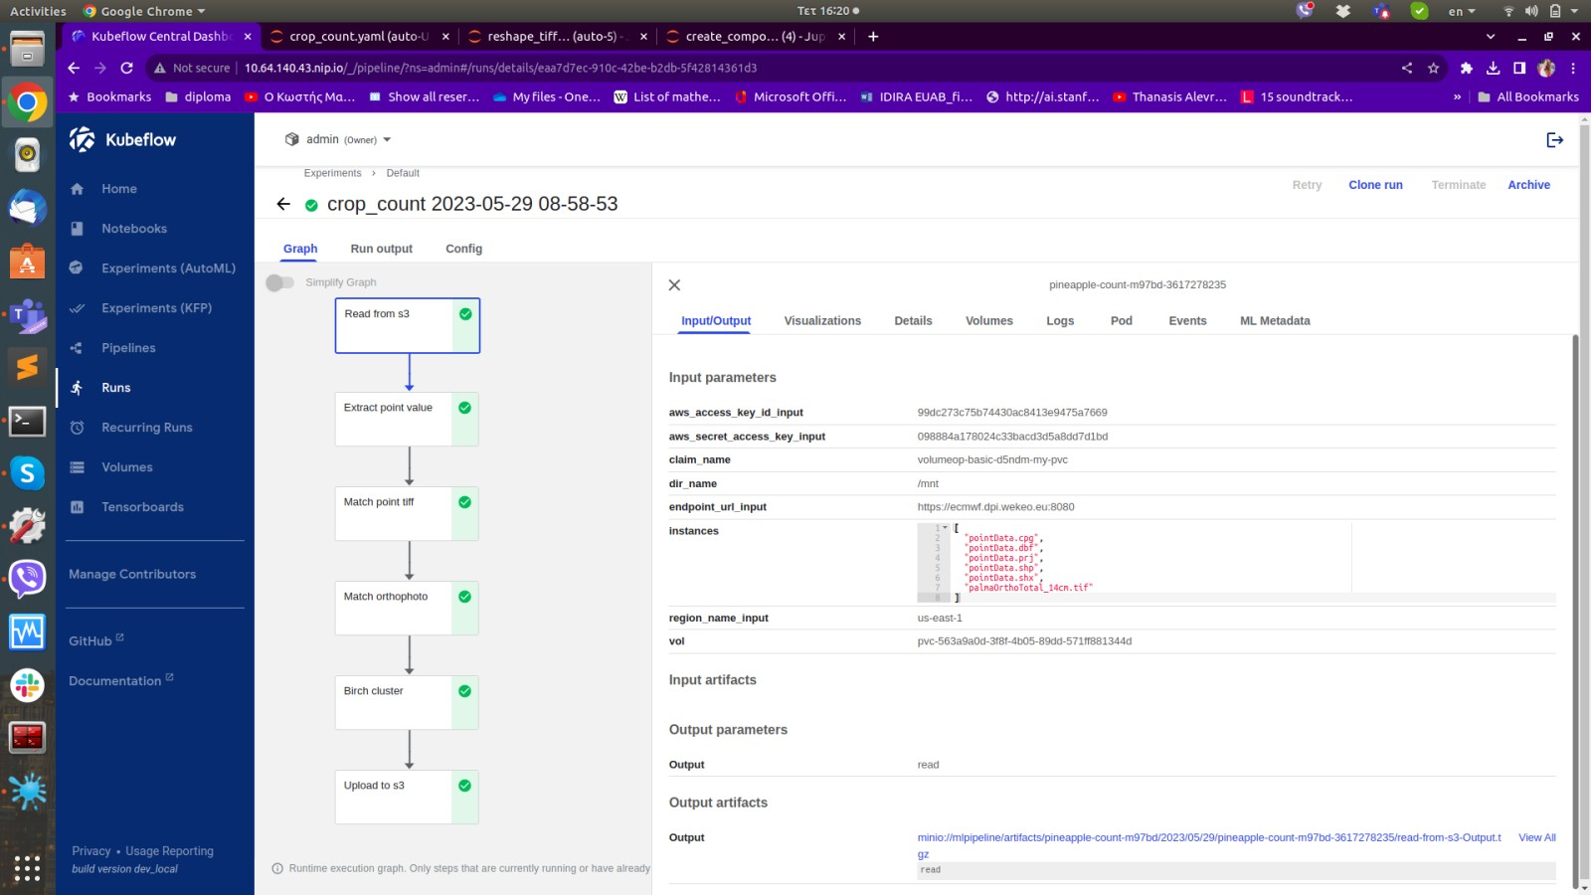
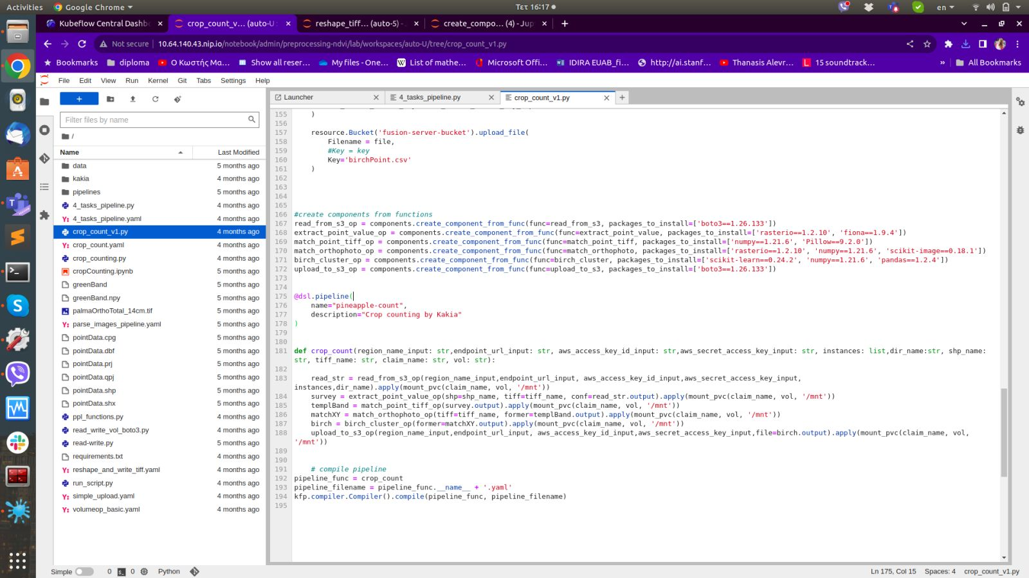
FUSION workflow setup

Slide 33
Fusion Engine
  The model will provide higher level aggregated information about the datasets..
Each pipeline supports different types of data
TIFFs
Shapefiles
NetCDF
CSV
Grib
Fusion Models
Preprocessing of tiff data
Spatiotemporal merging of information based on different tiffs or shapefiles
E.g., NDVI calculation, Crop identification/Crop counting

Slide 34

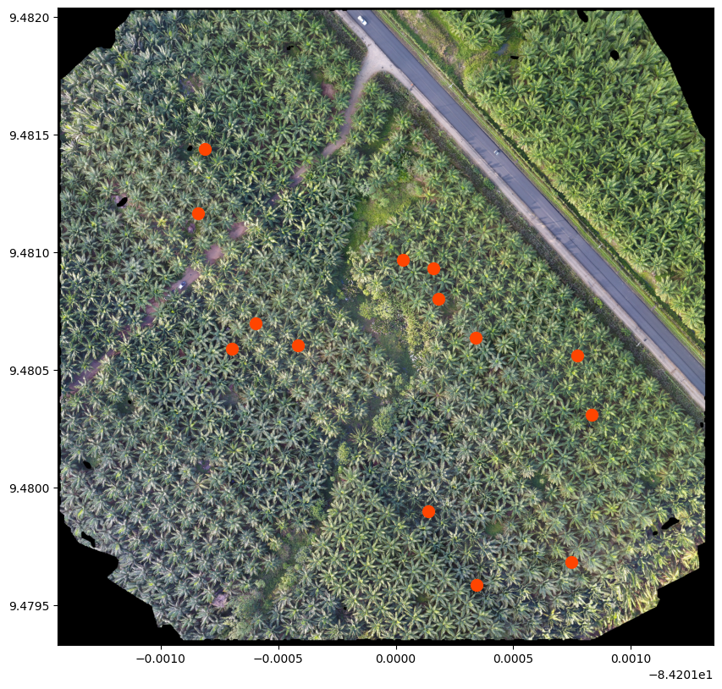
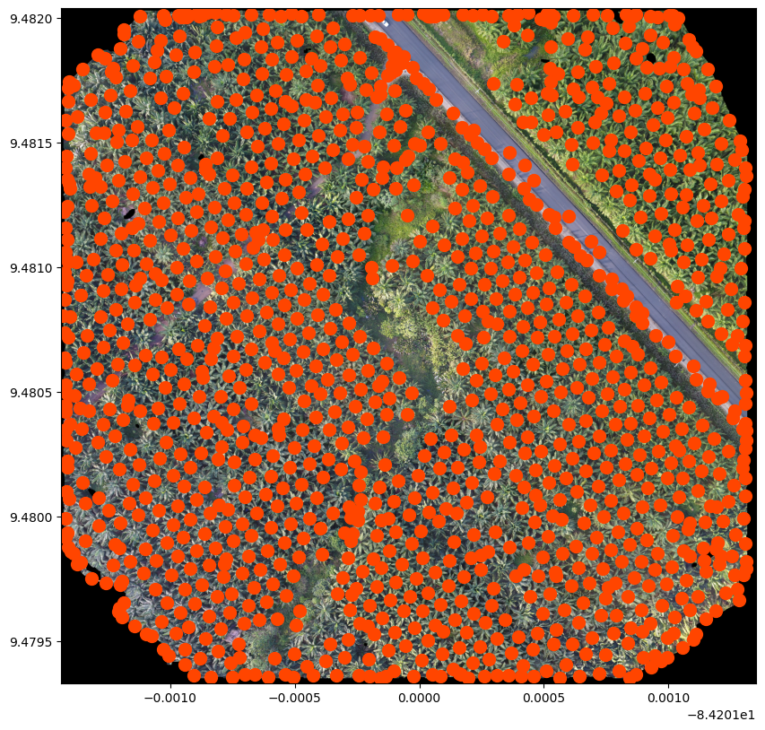
Example of Geospatial Counting
Read
tiff
Extract point value from raster
Cluster Analysis
Read
shapefile
Create template images
Match template image to orthophoto
Export csv
848, 1162
875, 1263
689, 471
1693, 1246
1940, 1408
1864, 1727
1368, 1796
1168, 1748
979, 1279
1108, 1407
1147, 586
473, 494
1062, 667
1136, 808

Slide 35
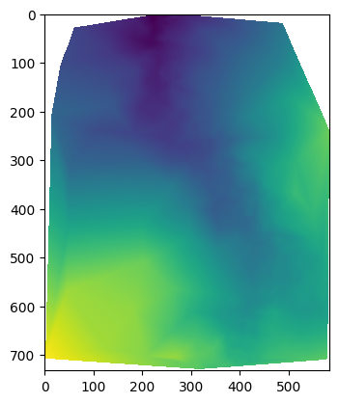
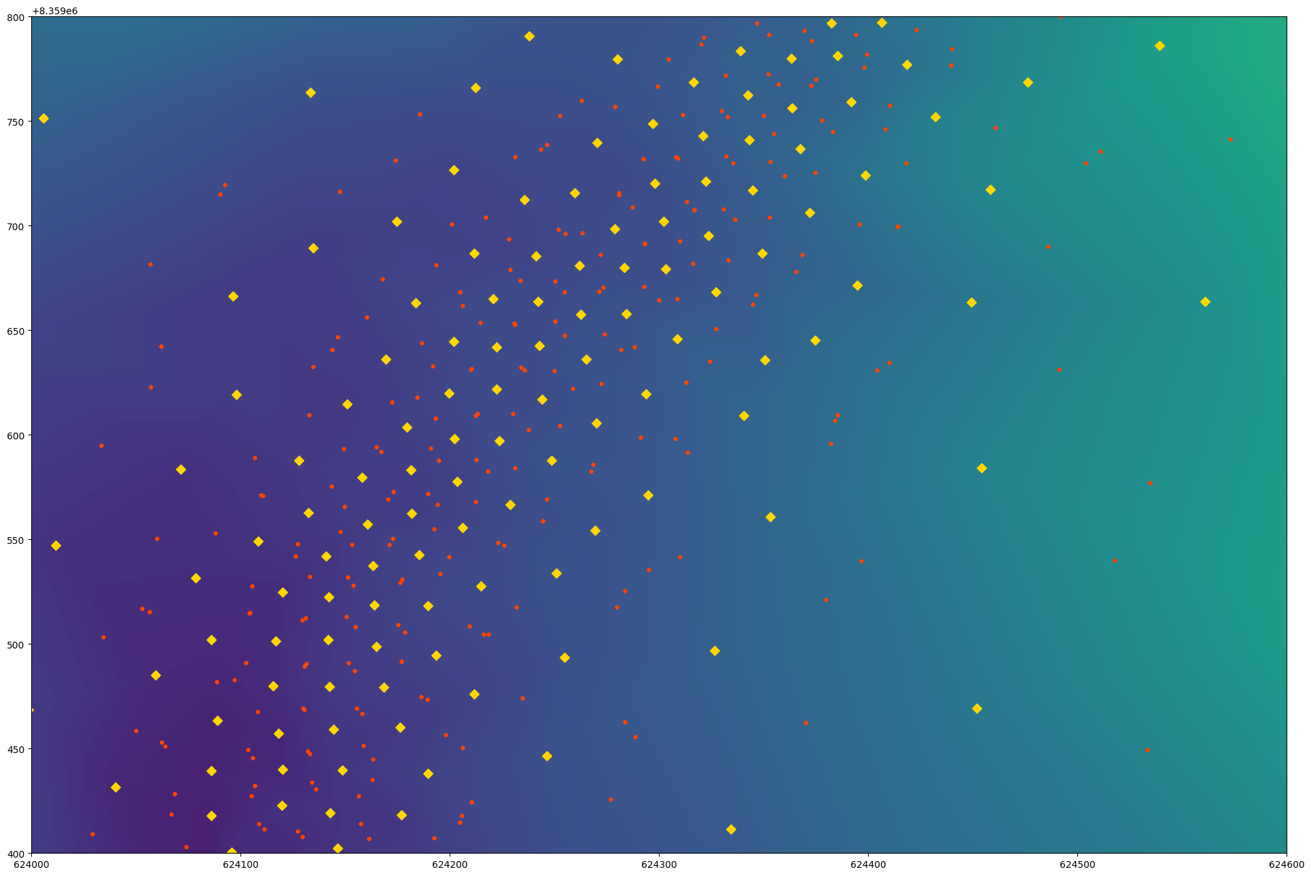
Example 2 Spatial Interpolation
Read
shapefile
Triangulation Transformation
Interpolated raster representation
Raster transformation
Interpolation
Representation of input and output data
Save raster as new TIFF

